Slide 1

Functional Pathways
MDS Section K-P
Notes:
Smokey and the Bandits theme song. . . .by Jerry Reed
We have a long way to go and a short time to get there . . .

Slide 2

Section K
Swallowing/Nutritional Status-Assess conditions that could affect the resident’s ability to maintain adequate nutrition and hydration.
Therapy services and intellectual property provided by Functional Pathways. ©2022 All rights reserved. This information and materials were created by and is proprietary to Functional Pathways of Tennessee, LLC. Any unauthorized use, dissemination, distribution, or copying of this information and material, in whole or in part, is strictly prohibited.
Notes:
This section is about adequate nutrition and hydration.
Care plans should monitor the resident during meals and functions/activities that include the consumption of food/liquids.
If signs and symptoms arise the physician, RD, SLP, OT and nursing staff should be made aware.
Diet consistency
Compensatory strategies
Positioning during and following meals
SLP, OT, Dietician, nursing, activities and dietary/kitchen staff should collaborate in this section

Slide 3
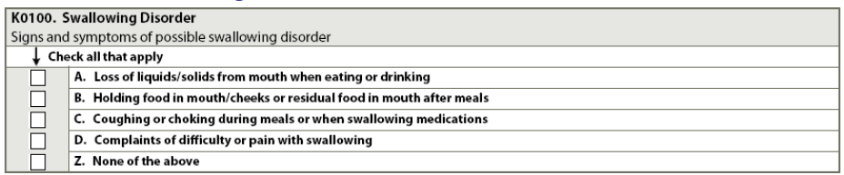
K0100-Swallowing Disorder
Code even if the symptom occurred only once during 7-day look-back period
Assessment of multiple shifts/multiple staff interviews
Review SLP documentation, referral to SLP may be beneficial
Registered Dietician/Kitchen Staff should be aware and interviewed
Don’t forget the intake of medication
**Section L-dental problems, Section N-Pain
Therapy services and intellectual property provided by Functional Pathways. ©2022 All rights reserved. This information and materials were created by and is proprietary to Functional Pathways of Tennessee, LLC. Any unauthorized use, dissemination, distribution, or copying of this information and material, in whole or in part, is strictly prohibited.
Notes:
A: Foot or liquids dribbles down chin or falls out of mouth
B. pocketing, failed to empty mouth completely
C. Resident may cough or gag, turn red, have labored breathing, difficulty swallowing. Resident explains by saying “going down the wrong way”
D. May refuse food because of pain (temperature of food/drink, texture, grows in the mouth and can not swallow
Z. None of these
Section L: Poor fitting dentures
No teeth
Mouth sores/abscess/cavity
Tumors
Pain
***Do not code if interventions have been successful and no sign/symptoms of the problem existed in 7-day look-back period

Slide 4
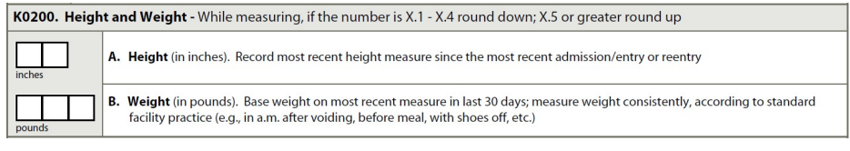
K0200-Height/Weight
Height- measure and record in inches upon admission
Round to nearest whole inch (.5 or greater round up, .4 or lower round down)
74.5 inches- code as 75 inches
60.4 inches-code as 60 inches
Should be within the last year or retake and round to nearest inch for additional assessments
Weight-measure and record in pounds upon admission
Round to nearest pound (.5 or greater round up, .4 or lower round down)
152.5 pounds-code as 153
170.4 pounds-code as 170
If resident can not be weighed because of pain, immobility, risk of fractures use (-) and document rationale in resident’s medical record.
Record most recent weight within the last 30 days for additional assessments
Therapy services and intellectual property provided by Functional Pathways. ©2022 All rights reserved. This information and materials were created by and is proprietary to Functional Pathways of Tennessee, LLC. Any unauthorized use, dissemination, distribution, or copying of this information and material, in whole or in part, is strictly prohibited.
Notes:
Do you have a policy
Do you have residents wear shoes? Take off clothes around bath time, account for AD or w/c weight?
Don’t have to frequently check height, but you do need to assess at least yearly for assessments
Fun fact: We are tallest first thing in the morning when our intervertebral disks have the most water in them after a nights rest.

Slide 5
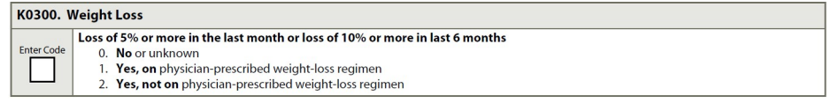
K0300: Weight Loss
Can result in debility, affect health, safety and quality of life
Weight loss due to morbid obesity or fluid overload can improve quality of life.
5% in 30 days-take residents weight closest to 30 days ago x .95. This figure is the 5% loss.
10% in 180 days-take residents weight closest to 180 days ago x .90. This figure is the 10% loss.
Physician-Prescribed weight loss regimen
calorie-restricted
weight loss diet/exercise
planned diuresis
Therapy services and intellectual property provided by Functional Pathways. ©2022 All rights reserved. This information and materials were created by and is proprietary to Functional Pathways of Tennessee, LLC. Any unauthorized use, dissemination, distribution, or copying of this information and material, in whole or in part, is strictly prohibited.
Notes:
BMI: Number calculated from a person’s weight and height. BMI is used as a screening tool to identify possible weight problems for adults
Weight changes of 5% in 1 month, 7.5% in 3 months, or 10% in 6 months should prompt a thorough assessment of the resident’s nutritional status
Rely on your RD for assistance in this area.

Slide 6
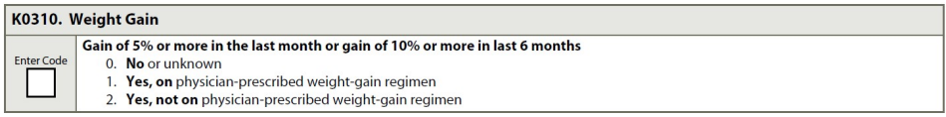
K0310: Weight Gain
Can result in debility, adversely affect health, safety and quality of life
5% in 30 days-take residents weight closest to 30 days ago x 1.05. This figure is the 5% gain.
10% in 180 days-take residents weight closest to 180 days ago x 1.10. This figure is the 10% gain.
Therapy services and intellectual property provided by Functional Pathways. ©2022 All rights reserved. This information and materials were created by and is proprietary to Functional Pathways of Tennessee, LLC. Any unauthorized use, dissemination, distribution, or copying of this information and material, in whole or in part, is strictly prohibited.
Notes:
Weight changes of 5% in 1 month, 7.5% in 3 months, or 10% in 6 months should prompt a thorough assessment of the resident’s nutritional status
We need to be proactive and not reactive . . . Think QM’s.
Edema, fluid retention reasons to discuss weight changes with physician.
Rely on your RD for assistance with this information.

Slide 7
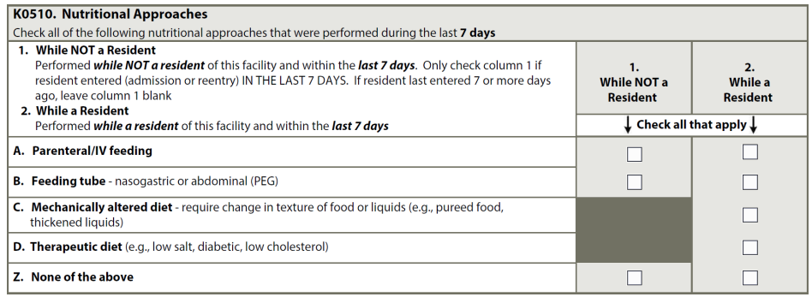
Nutritional Approaches
Therapy services and intellectual property provided by Functional Pathways. ©2022 All rights reserved. This information and materials were created by and is proprietary to Functional Pathways of Tennessee, LLC. Any unauthorized use, dissemination, distribution, or copying of this information and material, in whole or in part, is strictly prohibited.
Notes:
Parenteral/IV feeding-When there is supporting documentation that reflects the need for additional fluid intake specifically addressing a nutrition or hydration need. This supporting documentation should be noted in the resident’s medical record according to State and/or internal facility policy:
Therapeutic diets are not defined by the content of what is provided or when it is served, but why the diet is required-heart healthy, no added salt, diabetic, low cholesterol
Food elimination diets related to food allergies (e.g. peanut allergy) can be coded as a therapeutic diet
A nutritional supplement may be part of a therapeutic diet to manage a problematic health condition-protein-calorie malnutrition.

Slide 8

K0510: Nutritional Approaches Parenteral/IV Feedings-introduction of nutritive substance into the body by means other than GI system (subcutaneous, intravenous) ***Nursing CMG, NTA point
Include in K0510A
Don’t include in K0510A
IV fluids or hyperalimentation, including total parenteral nutrition (TPN), administered continuously or intermittently
IV fluids running at KVO (Keep Vein Open)
IV fluids contained in IV Piggybacks
Hypodermoclysis and subcutaneous ports in hydration therapy
IV fluids can be coded in K0510A if needed to prevent dehydration if the additional fluid intake is specifically needed for nutrition and hydration.
Prevention of dehydration should be clinically indicated and supporting documentation should be provided in the medical record.
IV Medications- Code these when appropriate in O0100H, IV Medications.
IV fluids used to reconstitute and/or dilute medications for IV administration.
IV fluids administered as a routine part of an operative or diagnostic procedure or recovery room stay.
IV fluids administered solely as flushes.
Parenteral/IV fluids administered in conjunction with chemotherapy or dialysis.
Enteral feeding formulas:
Should not be coded as a mechanically altered diet.
Should only be coded as K0510D, Therapeutic Diet when the enteral formula is altered to manage problematic health conditions, e.g. enteral formulas specific to diabetics
Therapy services and intellectual property provided by Functional Pathways. ©2022 All rights reserved. This information and materials were created by and is proprietary to Functional Pathways of Tennessee, LLC. Any unauthorized use, dissemination, distribution, or copying of this information and material, in whole or in part, is strictly prohibited.

Slide 9
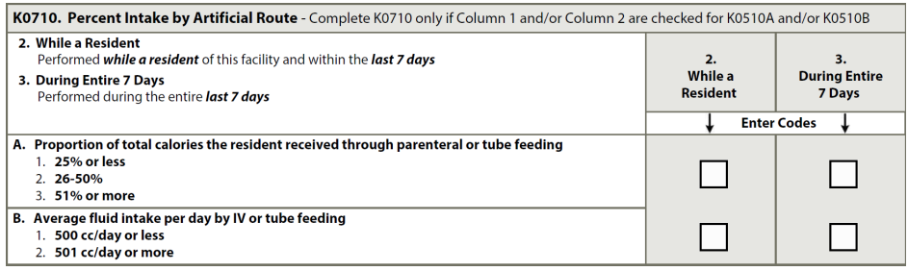
K0710:Percentage Intake by Artificial Route
Only complete if K0510A (Parenteral/IV) and/or K0510B (Feeding tube) are checked
Review intake records
Consult Dietician/direct care staff
K0710A-is average amount of calorie intake over 7 days
Add up total amount of calories received each day by IV and/or tube feedings and orally
Add total calorie intake, Divide this number by 7 = average calorie intake/day
K0710B-is average amount of fluids intake over 7 days
Add up total amount of fluids received each day by IV and/or tube feedings and orally
Add total fluid intake, Divide this number by 7 = average fluid intake/day
Therapy services and intellectual property provided by Functional Pathways. ©2022 All rights reserved. This information and materials were created by and is proprietary to Functional Pathways of Tennessee, LLC. Any unauthorized use, dissemination, distribution, or copying of this information and material, in whole or in part, is strictly prohibited.
Notes:
Is this over the entire look back period for both A and B?

Slide 10
Scenario: Mr. H has had a feeding tube since his surgery two weeks ago. He is currently more alert and feeling much better. He is very motivated to have the tube removed. He has been taking soft solids by mouth, but only in small to medium amounts.
For the past 7 days, he has been receiving tube feedings for nutritional supplementation. The dietitian has totaled his calories per day as follows:
Oral Tube
Sun. 500 2,000
Mon. 250 2,250
Tues. 250 2,250
Wed. 350 2,250
Thurs. 500 2,000
Fri. 250 2,250
Sat. 350 2,000
Total 2,450 15,000
Coding: K0710A columns 2 and 3 would be coded 3, 51% or more.
Rationale: Total Oral intake is 2,450 calories
Total Tube intake is 15,000 calories
Total calories is 2,450 + 15,000 = 17,450
Calculation of the percentage of total calories by tube feeding: 15,000/17,450 = .859 X 100 = 85.9%
Mr. H received 85.9% of his calories by tube feeding, therefore K0710A code 3, 51% or more is correct.
Therapy services and intellectual property provided by Functional Pathways. ©2022 All rights reserved. This information and materials were created by and is proprietary to Functional Pathways of Tennessee, LLC. Any unauthorized use, dissemination, distribution, or copying of this information and material, in whole or in part, is strictly prohibited.

Slide 11

Section L:
Oral/Dental Status-Record any oral or dental problems present.
Therapy services and intellectual property provided by Functional Pathways. ©2022 All rights reserved. This information and materials were created by and is proprietary to Functional Pathways of Tennessee, LLC. Any unauthorized use, dissemination, distribution, or copying of this information and material, in whole or in part, is strictly prohibited.

Slide 12
Poor oral health has a negative impact
Resident may be affected by:
Quality of life
Overall health
Aspiration
Malnutrition
Pneumonia
Endocarditis
Poor control of Diabetes
Nutritional status
Who needs to know: IDT
Provider
Dietician
Therapists
Nurse
CNA’s
Activities
Social Workers
Therapy services and intellectual property provided by Functional Pathways. ©2022 All rights reserved. This information and materials were created by and is proprietary to Functional Pathways of Tennessee, LLC. Any unauthorized use, dissemination, distribution, or copying of this information and material, in whole or in part, is strictly prohibited.
Notes:
Talked about speech, teeth and dental health when we talked about section B and section K.

Slide 13
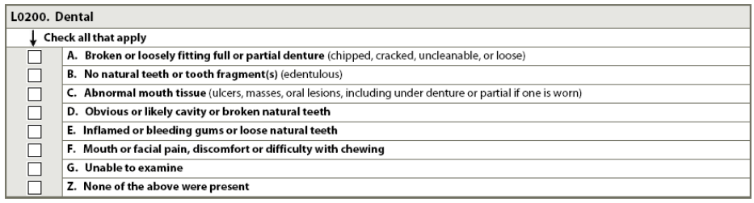
L0200-Dental
Therapy services and intellectual property provided by Functional Pathways. ©2022 All rights reserved. This information and materials were created by and is proprietary to Functional Pathways of Tennessee, LLC. Any unauthorized use, dissemination, distribution, or copying of this information and material, in whole or in part, is strictly prohibited.

Slide 14
Definitions for Oral/Dental Status
Cavity-tooth with discolored hole or area of decay
Broken Natural Teeth or tooth fragment
Oral lesions-discolored area of tissue on the lips, gums, tongue, palate, cheek lining or throat.
Edentulous-having no natural permanent teeth in the mouth. Complete tooth loss.
Oral mass-swollen or raised lump, bump or nodule on any oral surface
Ulcer-mouth sore, blister or eroded area of tissue on any oral surface
***Mouth pain should be coded in Section J and Section L
Therapy services and intellectual property provided by Functional Pathways. ©2022 All rights reserved. This information and materials were created by and is proprietary to Functional Pathways of Tennessee, LLC. Any unauthorized use, dissemination, distribution, or copying of this information and material, in whole or in part, is strictly prohibited.

Slide 15
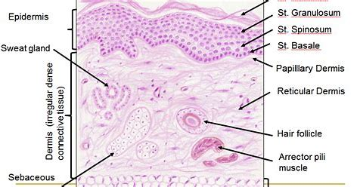
Section M:
Skin Conditions-Document the risk, presence, appearance, and change of pressure ulcers as well as other skin ulcers, wounds or lesions. Also includes treatment categories related to skin injury or avoiding injury.
Therapy services and intellectual property provided by Functional Pathways. ©2022 All rights reserved. This information and materials were created by and is proprietary to Functional Pathways of Tennessee, LLC. Any unauthorized use, dissemination, distribution, or copying of this information and material, in whole or in part, is strictly prohibited.

Slide 16
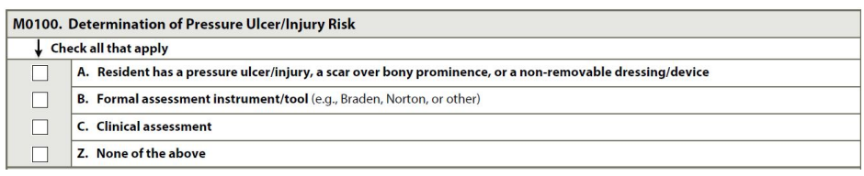
Is the Resident at risk?
Review the medical record
Speak with direct care staff on ALL shifts
Examine the resident-head to toe assessment in a well-lit room
Therapy services and intellectual property provided by Functional Pathways. ©2022 All rights reserved. This information and materials were created by and is proprietary to Functional Pathways of Tennessee, LLC. Any unauthorized use, dissemination, distribution, or copying of this information and material, in whole or in part, is strictly prohibited.
Notes:
Non-removable dressing/device-primary surgical dressing, a cast or a brace
Formal assessment-Braden Scale for Predicting Pressure Sore Risk
Clinical assessment: head to toe physical examination of the skin and observation or medical record review of pressure ulcer/injury risk factors
impaired mobility
impaired diffuse or localized blood flow
Cognitive impairments
UTI/fecal incontinence
Malnutrition

Slide 17
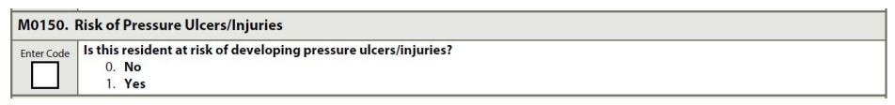
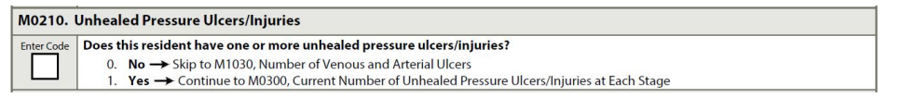
M0150 Risk of Pressure Ulcers/Injuries
Evaluate each resident for risk factors
Identify and evaluate all areas of risk for constant pressure
M0210: Unhealed Pressure Ulcers/Injuries
Therapy services and intellectual property provided by Functional Pathways. ©2022 All rights reserved. This information and materials were created by and is proprietary to Functional Pathways of Tennessee, LLC. Any unauthorized use, dissemination, distribution, or copying of this information and material, in whole or in part, is strictly prohibited.
Notes:
M0210-bony prominences, under braces, casts
Without a full body assessment, a pressure ulcer can be missed.
If a pressure ulcer is surgically closed with a flap or graft, it should be coded as a surgical wound and not as a pressure ulcer.
Scab and eschar are different both physical and chemically and needs the skill of a wound nurse to make sure it is coded ocrrect.ly.

Slide 18
Sacrum
Coccyx
Ears
Trochanters
Heels
Back of the Head
Elbows
Knees
Spinous Processes
Ischial tuberosities
Key areas of focus:
Therapy services and intellectual property provided by Functional Pathways. ©2022 All rights reserved. This information and materials were created by and is proprietary to Functional Pathways of Tennessee, LLC. Any unauthorized use, dissemination, distribution, or copying of this information and material, in whole or in part, is strictly prohibited.

Slide 19
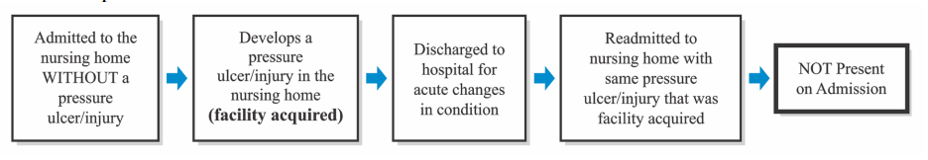
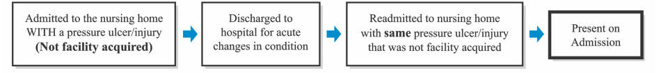
M0300 Current Number of Unhealed Pressure Ulcers/Injuries at End Stage
Therapy services and intellectual property provided by Functional Pathways. ©2022 All rights reserved. This information and materials were created by and is proprietary to Functional Pathways of Tennessee, LLC. Any unauthorized use, dissemination, distribution, or copying of this information and material, in whole or in part, is strictly prohibited.
Notes:
Pressure Ulcer Pathways from the RAI manual.

Slide 20
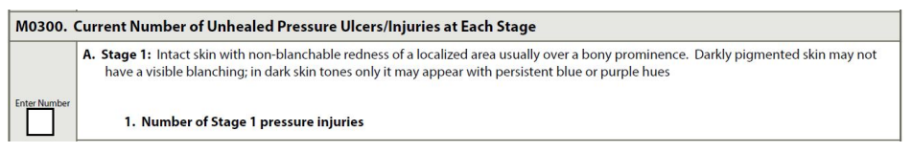
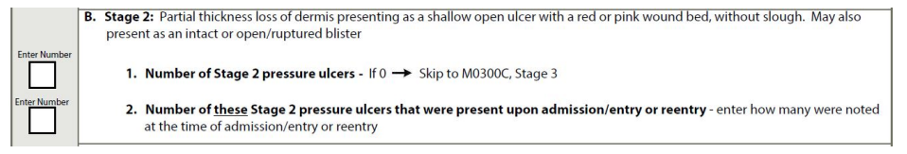
M0300A: Stage 1 Pressure Ulcer
Must be related to pressure only
Blanchable vs. non-blanchable
M0300B: Stage 2 Pressure Ulcers
Often related to friction and/or shearing force
Partial thickness loss of dermis
Therapy services and intellectual property provided by Functional Pathways. ©2022 All rights reserved. This information and materials were created by and is proprietary to Functional Pathways of Tennessee, LLC. Any unauthorized use, dissemination, distribution, or copying of this information and material, in whole or in part, is strictly prohibited.
Notes:
BLANCHABLE vs. NON-BLANCHABLE Reddened areas of tissue that do not turn white or pale when pressed firmly with a finger or device
Discuss with direct care staff for complete information.

Slide 21
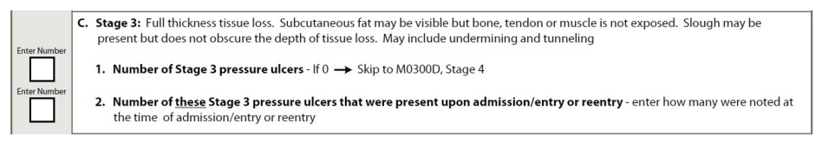
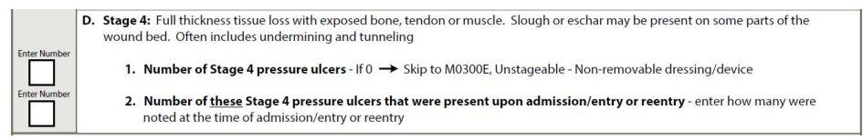
M0300C: Stage 3 Pressure Ulcers
Full thickness tissue loss
undermining or tunnelling
slough
M0300D: Stage 4 Pressure Ulcers
Full thickness tissue loss
Bone, tendon or muscle
Slough/eschar
Undermining/tunnelling
Therapy services and intellectual property provided by Functional Pathways. ©2022 All rights reserved. This information and materials were created by and is proprietary to Functional Pathways of Tennessee, LLC. Any unauthorized use, dissemination, distribution, or copying of this information and material, in whole or in part, is strictly prohibited.
Notes:
Discuss with direct care staff for complete information.
Italics means may be present with each stage

Slide 22
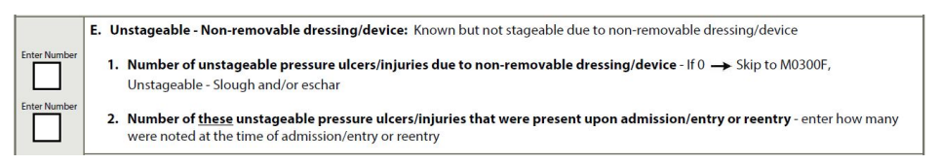
M0300E: Unstageable Pressure Ulcers/Injuries Related to Non-removable Dressing/Device
NON-REMOVABLE DRESSING/ DEVICE Includes, for example, a primary surgical dressing that cannot be removed, an orthopedic device, or cast
Therapy services and intellectual property provided by Functional Pathways. ©2022 All rights reserved. This information and materials were created by and is proprietary to Functional Pathways of Tennessee, LLC. Any unauthorized use, dissemination, distribution, or copying of this information and material, in whole or in part, is strictly prohibited.

Slide 23
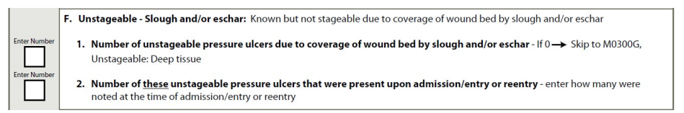
M0300F: Unstageable Pressure Ulcers Related to Slough and/or Eschar
Slough tissue-yellow, tan, gray, green or brown, moist, stringy, mucinous texture
Eschar tissue-black, brown or tan, appears scab-like, leathery
Fluctuance- underlying, unexposed fluid
Therapy services and intellectual property provided by Functional Pathways. ©2022 All rights reserved. This information and materials were created by and is proprietary to Functional Pathways of Tennessee, LLC. Any unauthorized use, dissemination, distribution, or copying of this information and material, in whole or in part, is strictly prohibited.
Notes:
Pressure ulcers with slough, eschar on the wound bed that can not be visualized are unstageable until depth of soft tissue damage can be exposed and assessed.

Slide 24
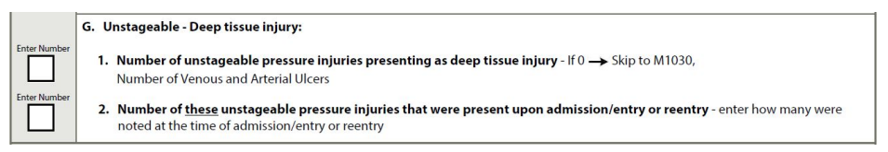
M0300G: Unstageable Pressure Injuries Related to Deep Tissue Injury
Deep tissue injury: purple or maroon area of discolored intact skin due to damage of underlying soft tissue.
The area may be preceded by tissue that is painful, firm, mushy, boggy, warmer or cooler as compared to adjacent tissue
When the DTI opens to an ulcer → code the reclassified ulcer stage
Therapy services and intellectual property provided by Functional Pathways. ©2022 All rights reserved. This information and materials were created by and is proprietary to Functional Pathways of Tennessee, LLC. Any unauthorized use, dissemination, distribution, or copying of this information and material, in whole or in part, is strictly prohibited.
Notes:
TUNNELING A passageway of tissue destruction under the skin surface that has an opening at the skin level from the edge of the wound.
UNDERMINING The destruction of tissue or ulceration extending under the skin edges (margins) so that the pressure ulcer is larger at its base than at the skin surface

Slide 25
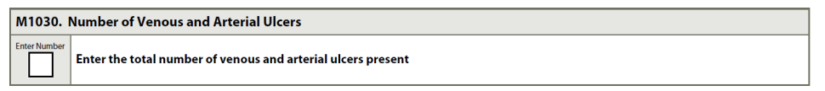
M1030: Number of Venous and Arterial Ulcers
Venous ulcers caused by peripheral venous disease, which most commonly occur proximal to the medial or lateral malleolus, above the inner or outer ankle, or on the lower calf area of the leg
May or may not be painful
Irregular wound bed
Wet, moist, drainage
Arterial ulcers caused by peripheral arterial disease, which commonly occur on the tips and tops of the toes, tops of the foot, or distal to the medial malleolus.
Painful
Pale pink wound bed
Dry
Necrotic tissue
Therapy services and intellectual property provided by Functional Pathways. ©2022 All rights reserved. This information and materials were created by and is proprietary to Functional Pathways of Tennessee, LLC. Any unauthorized use, dissemination, distribution, or copying of this information and material, in whole or in part, is strictly prohibited.

Slide 26
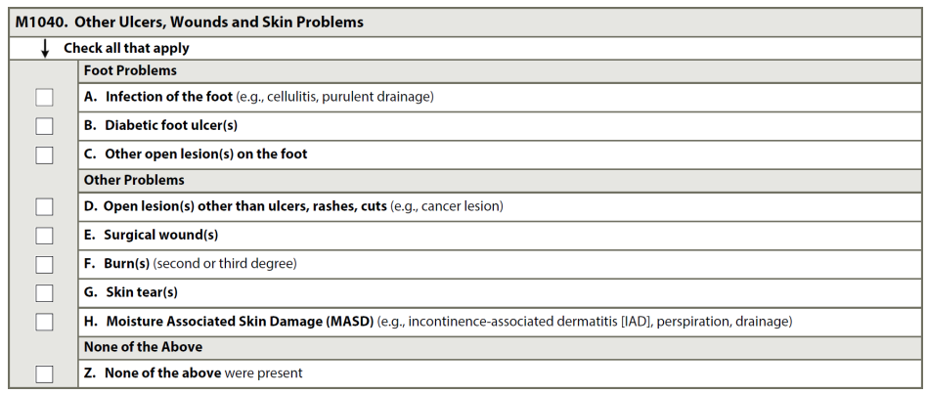
M1040: Other Ulcers, Wounds and Skin Problems
Review medical record
Speak with direct care staff
Therapy services and intellectual property provided by Functional Pathways. ©2022 All rights reserved. This information and materials were created by and is proprietary to Functional Pathways of Tennessee, LLC. Any unauthorized use, dissemination, distribution, or copying of this information and material, in whole or in part, is strictly prohibited.
Notes:
Recommend you refer to the RAI manual for specifics.
C: Other open lesions of foot-cuts, fissures (dry skin on heels)
D: Open lesions other than ulcers, rashes, cuts-wounds, boils, cysts and vesicles
E: surgical wounds-do not include healed wounds, stomas or lacerations that require suturing or butterfly closure. Do not include-PICC sites, central lines and peripheral IV sites

Slide 27
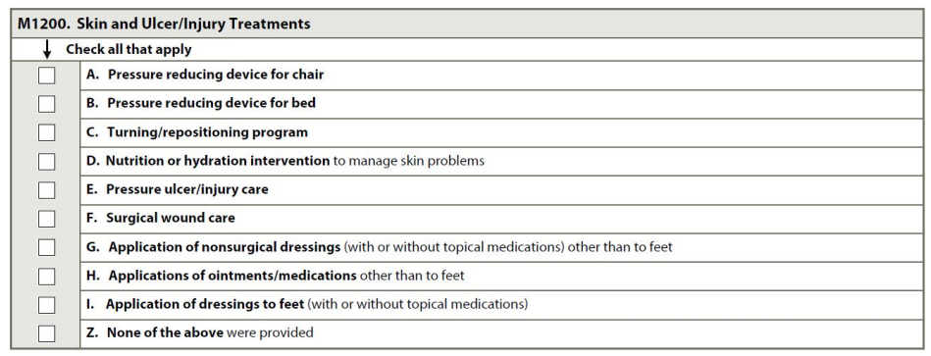
M1200-Skin and Ulcer/Injury Treatments
Review medical record
Speak with direct care staff
Therapy services and intellectual property provided by Functional Pathways. ©2022 All rights reserved. This information and materials were created by and is proprietary to Functional Pathways of Tennessee, LLC. Any unauthorized use, dissemination, distribution, or copying of this information and material, in whole or in part, is strictly prohibited.
Notes:
PRESSURE REDUCING DEVICE(S) Equipment that aims to relieve pressure away from areas of high risk. May include foam, air, water gel, or other cushioning placed on a chair, wheelchair, or bed. Include pressure relieving, pressure reducing, and pressure redistributing devices. Devices are available for use with beds and seating
A & B: Do not include egg crate cushions of any type, doughnut or ring devices for chairs
C: Turning/repositioning program-Includes a consistent program for changing the resident’s position and realigning the body. “Program” is defined as a specific approach that is organized, planned, documented, monitored, and evaluated based on an assessment of the resident’s needs
D: Nutrition or hydration intervention to manage skin problems-Dietary measures received by the resident for the purpose of preventing or treating specific skin conditions, e.g., wheat-free diet to prevent allergic dermatitis, high calorie diet with added supplementation to prevent skin breakdown, high-protein supplementation for wound healing
E: Pressure ulcer/injury care-examples
use of topical dressings; enzymatic, mechanical or surgical debridement; wound irrigations; negative pressure wound therapy (NPWT); and/or hydrotherapy.
F: surgical wound care-e topical cleansing, wound irrigation, application of antimicrobial ointments, application of dressings of any type, suture/staple removal, and warm soaks or heat application
excision of pressure ulcer with flap and/or graft coverage
***once a pressure ulcer is excised and flap and/or graft applied, it is no longer considered a pressure ulcer, but a surgical wound.
***does not include post-operative care following eye or oral surgery
G: , dry gauze dressings, dressings moistened with saline or other solutions, transparent dressings, hydrogel dressings, and dressings with hydrocolloid or hydroactive particles used to treat a skin condition, compression bandages, etc.
***Non-surgical dressings do not include band-aid or wound closure strips
H: topical creams, powders, and liquid sealants used to treat or prevent skin condition
ointments or medications used to treat a skin condition (e.g., cortisone, antifungal preparations, chemotherapeutic agents).
I: intervention to treat any foot wound or ulcer other than a pressure ulcer/injury
***dressing on the ankle is not considered the foot. Ankle is the ankle and the foot is the foot!

Slide 28

Section N:
Medications-Record the number of days that any type of injection, insulin, and/or select medications was received by the resident.
Therapy services and intellectual property provided by Functional Pathways. ©2022 All rights reserved. This information and materials were created by and is proprietary to Functional Pathways of Tennessee, LLC. Any unauthorized use, dissemination, distribution, or copying of this information and material, in whole or in part, is strictly prohibited.
Notes:
Antipsychotic Medication Review is also found here.

Slide 29
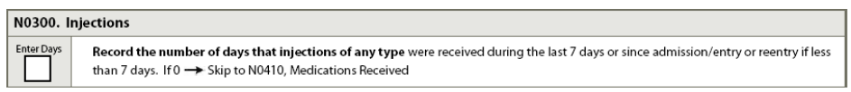
N0300-Injections
Count the number of days that the resident received any type of injection while a resident of the facility. (Count # of days not # of injections per day)
subcutaneous, intramuscular, or intradermal
Medication
Antigen
Vaccine
**insulin is captured here and in N0350
Therapy services and intellectual property provided by Functional Pathways. ©2022 All rights reserved. This information and materials were created by and is proprietary to Functional Pathways of Tennessee, LLC. Any unauthorized use, dissemination, distribution, or copying of this information and material, in whole or in part, is strictly prohibited.
Notes:
Subcutaneous pumps-only code the number of days the resident actually required a subcutaneous injection to restart the pump
If a patient received an antigen on one day and a vaccination on the following day . . . The number of days the resident received injections would be coded as 2 days.
If two injections were administered on the same day, the number of days the resident received injections would be coded as 1 day.

Slide 30
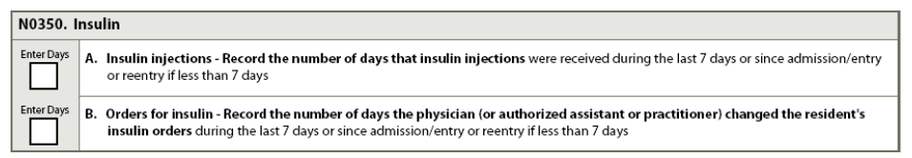
N0350-Insulin
Number of days in the 7-day look-back period that insulin injections were received
Number of days in the 7-day look-back period that the physician (NP, PA or Clinical Nurse Specialist) changed the resident’s insulin order
Nursing CMG-Special Care High if 2 or more insulin changes.
Therapy services and intellectual property provided by Functional Pathways. ©2022 All rights reserved. This information and materials were created by and is proprietary to Functional Pathways of Tennessee, LLC. Any unauthorized use, dissemination, distribution, or copying of this information and material, in whole or in part, is strictly prohibited.
Notes:
We know that insulin is used to treat DM.
**number of days insulin was received not number of injections received
Review the medical record for insulin changes . . . Important for NSG CMG
If the sliding scale order is new, discontinued or is the first sliding scale order for the resident this can be counted and coded.

Slide 31
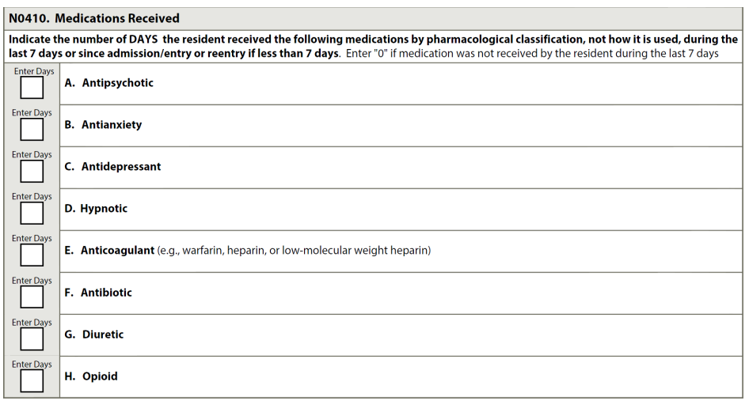
N0410 Medication Received
Number of days in 7-day look-back period (even if given only once)
Count long acting (decanoates given monthly)-if given during look-back period
Code medications based on therapeutic category and/or pharmacological classification-not how it is used
Combination medications that have more than one category should be coded in all categories regardless of how it is used.
Any route-PO, IM, IV
Any setting-SNF, ED-while a resident at the nursing home
Gradual dose reduction
Medication interactions/side effects
Non-pharmacological intervention-sleeping
QM-antipsychotic, antianxiety, hypnotic medications
Therapy services and intellectual property provided by Functional Pathways. ©2022 All rights reserved. This information and materials were created by and is proprietary to Functional Pathways of Tennessee, LLC. Any unauthorized use, dissemination, distribution, or copying of this information and material, in whole or in part, is strictly prohibited.
Notes:
Residents who are taking medication in this category are at risk for side effects that affect health, safety and quality of life. -confusion, sedation and falls . . .
Consider nonpharmacological approaches when possible or in conjunction with use of medications to possible reduce dose and duration of medications
Count long acting-Fluphenazine decanoate and haloperidol decanoate
Transdermal patches are long acting if applied during the look back period-count for each application only.
If you are confused about the medication classification consult the medication package insert, speak with a pharmacist or refer to the resources/link in the RAI manual.
Herbal and alternative medicine products are considered to be dietary supplements by the FDA. (melatonin, chamomile, valerian root)

Slide 32
N0410: Medication Received
Example: The MAR for Mrs. B reflects the following
Risperidone 0.5 mg PO BID PRN: Received once a day on Monday, Wednesday, and Thursday.
Lorazepam 1 mg PO QAM: Received every day.
Temazepam 15 mg PO QHS PRN: Received at bedtime on Tuesday and Wednesday only.
Coding: Medications in N0410, would be coded as follows:
A. Antipsychotic = 3, risperidone is an antipsychotic medication,
B. Antianxiety = 7, lorazepam is an antianxiety medication
D. Hypnotic = 2, temazepam is a hypnotic medication.
***Please note: if a resident is receiving medications in all three categories simultaneously there must be a clear clinical indication for the use of these medications.
***Administration of these types of medications, particularly in this combination, could be interpreted as chemically restraining the resident.
***Adequate documentation is essential in justifying their use
Therapy services and intellectual property provided by Functional Pathways. ©2022 All rights reserved. This information and materials were created by and is proprietary to Functional Pathways of Tennessee, LLC. Any unauthorized use, dissemination, distribution, or copying of this information and material, in whole or in part, is strictly prohibited.

Slide 33
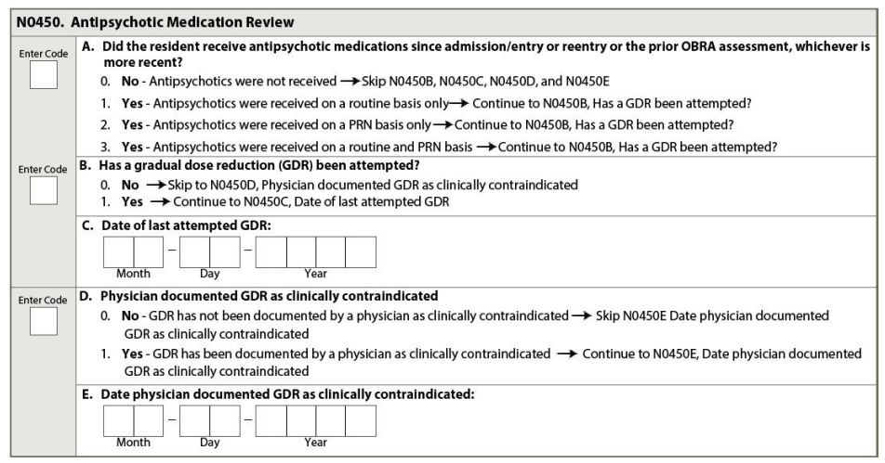
N0450: Antipsychotic medication review
Drug regimen review
GDR-gradual dose reduction
The facility must attempt a GDR in two separate quarters at lease one month apart within the first year the resident was admitted or after the facility initiated an antipsychotic medication. (unless provider documentation deems it clinically contraindicated)
After the first year it must be attempted at least annually unless clinically contraindicated.
Do not count GDR if switching from one med to another
GDR state date is the first day the resident received the reduced dose of the medication
If multiple antipsychotics are given on routine basis and one med was reduced or discontinued-record date in N0450C
If multiple GDR’s have been attempted record most recent in N0450C
Therapy services and intellectual property provided by Functional Pathways. ©2022 All rights reserved. This information and materials were created by and is proprietary to Functional Pathways of Tennessee, LLC. Any unauthorized use, dissemination, distribution, or copying of this information and material, in whole or in part, is strictly prohibited.
Notes:
Any medication that has a pharmacological classification or therapeutic category of antipsychotic medication must be recorded in this section, regardless of why the medication is being used.
Physician documentation indicating dose reduction attempts are clinically contraindicated must include the clinical rationale for why an attempted dose reduction is inadvisable. This decision should be based on the fact that tapering of the medication would not achieve the desired therapeutic effects and the current dose is necessary to maintain or improve the resident’s function, well-being, safety, and quality of life.

Slide 34
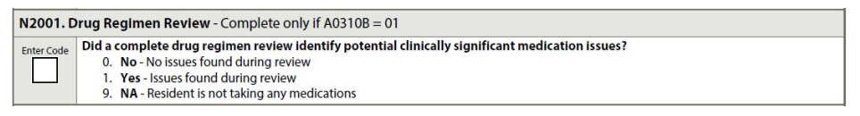
N2001-Drug Regimen Review
Complete if A0310A-01, Yes-PPS Assessment for Med A Stay-5 day
Medication reconciliation
Prevent potential clinically significant medication adverse consequences that may result in harm or death, ED visits and rehospitalizations
Prescription, over the counter meds, supplements, vitamins, homeopathic and herbal products administered by any route
TPN (total parenteral nutrition)
Oxygen
Therapy services and intellectual property provided by Functional Pathways. ©2022 All rights reserved. This information and materials were created by and is proprietary to Functional Pathways of Tennessee, LLC. Any unauthorized use, dissemination, distribution, or copying of this information and material, in whole or in part, is strictly prohibited.
Notes:
“Clinically significant” means effects, results, or consequences that materially affect or are likely to affect an individual’s mental, physical, or psychosocial well-being, either positively, by preventing a condition or reducing a risk, or negatively, by exacerbating, causing, or contributing to a symptom, illness, or decline in status.
Clinically significant medication issues may include, but are not limited to:
• Medication prescribed despite documented medication allergy or prior adverse reaction.
• Excessive or inadequate dose.
• Adverse reactions to medication.
• Ineffective drug therapy.
• Drug interactions (serious drug-drug, drug-food, and drug-disease interactions).
• Duplicate therapy (for example, generic-name and brand-name equivalent drugs are coprescribed).
• Wrong resident, drug, dose, route, and time errors.
• Medication dose, frequency, route, or duration not consistent with resident’s condition, manufacturer’s instructions, or applicable standards of practice.
• Use of a medication without evidence of adequate indication for use.
• Presence of a medical condition that may warrant medication therapy (e.g., a resident with primary hypertension does not have an antihypertensive medication prescribed).
• Omissions (medications missing from a prescribed regimen).
• Nonadherence (purposeful or accidental)

Slide 35
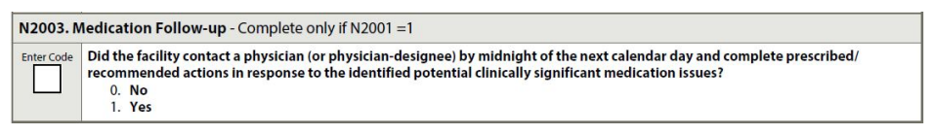
N2003- Medication Follow-up
Process of contacting a physician to communicate an identified medication issue and completing all physician prescribed/recommended actions by midnight of the next calendar day at the latest.
in person
by phone
voice mail
electronic means
fax . . .
Therapy services and intellectual property provided by Functional Pathways. ©2022 All rights reserved. This information and materials were created by and is proprietary to Functional Pathways of Tennessee, LLC. Any unauthorized use, dissemination, distribution, or copying of this information and material, in whole or in part, is strictly prohibited.
Notes:
Complete if N2001=1 Issues found during medical review

Slide 36
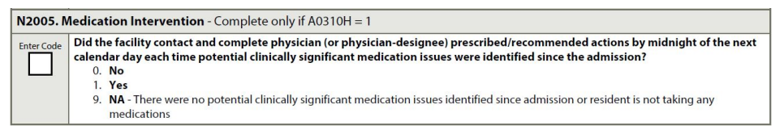
N2005-Medication Intervention
Complete if A0310H=1, Yes SNF Part A PPS Discharge Assessment
Code 0, No: if the facility did not contact the physician and complete prescribed/ recommended actions by midnight of the next calendar day each time a potential or actual clinically significant medication issue was identified since admission (start of SNF PPS stay).
Code 1, Yes: if the facility contacted the physician and completed prescribed/ recommended actions by midnight of the next calendar day each time a potential or actual clinically significant medication issue was identified since admission (start of SNF PPS stay).
Code 9, NA: if there were no potential or actual clinically significant medication issues identified at admission or throughout the resident’s stay or the resident was not taking any medications at admission or at any time throughout the stay
Therapy services and intellectual property provided by Functional Pathways. ©2022 All rights reserved. This information and materials were created by and is proprietary to Functional Pathways of Tennessee, LLC. Any unauthorized use, dissemination, distribution, or copying of this information and material, in whole or in part, is strictly prohibited.

Slide 37
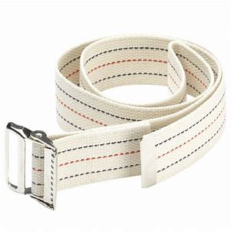
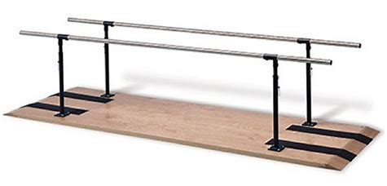
Section O:
Special Treatments, Procedures and Programs-Identify any special treatments, procedures and programs that the resident received during the specified time periods.
Therapy services and intellectual property provided by Functional Pathways. ©2022 All rights reserved. This information and materials were created by and is proprietary to Functional Pathways of Tennessee, LLC. Any unauthorized use, dissemination, distribution, or copying of this information and material, in whole or in part, is strictly prohibited.

Slide 38
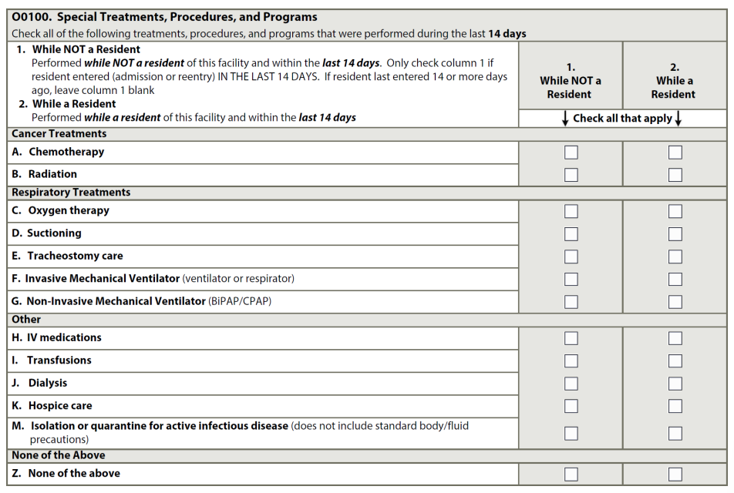
O0100:Special Treatments, Procedures and Programs
Column 1-treatment, procedures and programs received or performed by the resident prior to admission to the facility and within the 14-day look-back period
Column 2-treatment, procedures and programs received or performed by the resident after admission to the facility and within the 14-day look-back period
Facilities may code treatments, programs and procedures that the resident performed themselves independently or after set-up by facility staff
Do not code services that were provided solely in conjunction with a surgical procedure or diagnostic procedure
Therapy services and intellectual property provided by Functional Pathways. ©2022 All rights reserved. This information and materials were created by and is proprietary to Functional Pathways of Tennessee, LLC. Any unauthorized use, dissemination, distribution, or copying of this information and material, in whole or in part, is strictly prohibited.
Notes:
C:Bipap coded here in O0100
H: Code any drug or biological give by intravenous push, epidural pump or drp through a central or peripheral port here.
Epidural, intrathecal and baclofen pumps are coded here
Do not code flushes to keep IV open or IV fluids
Do not code IV meds related to dialysis or chemotherapy
I: blood or any blood products that are administered directly into the blood stream
Do not include transfusions administered during dialysis or chemotherapy.
M: Code only when the resident requires transmission-based precautions and single room isolation (alone in a separate room) because of active infection (i.e., symptomatic and/or have a positive test and are in the contagious stage) with highly transmissible or epidemiologically significant pathogens that have been acquired by physical contact or airborne or droplet transmission.
Code for “single room isolation” only when all of the following conditions are met:
1. The resident has active infection with highly transmissible or epidemiologically significant pathogens that have been acquired by physical contact or airborne or droplet transmission.
2. Precautions are over and above standard precautions. That is, transmission-based precautions (contact, droplet, and/or airborne) must be in effect.
3. The resident is in a room alone because of active infection and cannot have a roommate. This means that the resident must be in the room alone and not cohorted with a roommate regardless of whether the roommate has a similar active infection that requires isolation.
4. The resident must remain in his/her room. This requires that all services be brought to the resident (e.g. rehabilitation, activities, dining, etc.)

Slide 39

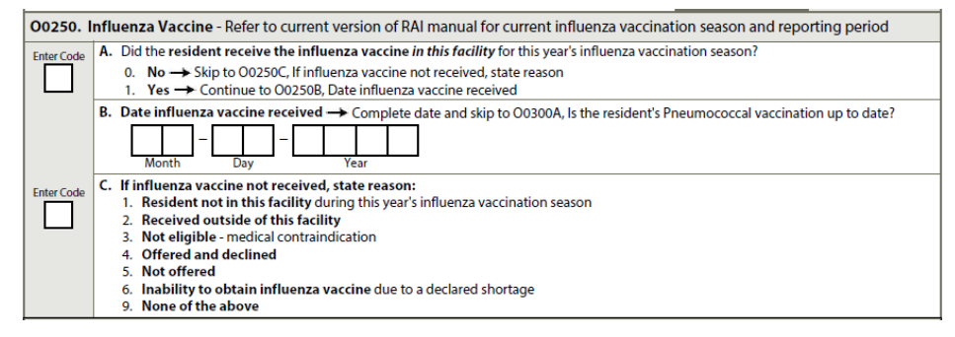
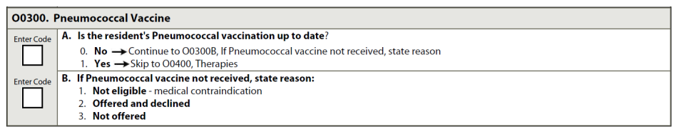
O0250 Influenza Vaccine
O0300 Pneumococcal Vaccine
Therapy services and intellectual property provided by Functional Pathways. ©2022 All rights reserved. This information and materials were created by and is proprietary to Functional Pathways of Tennessee, LLC. Any unauthorized use, dissemination, distribution, or copying of this information and material, in whole or in part, is strictly prohibited.

Slide 40
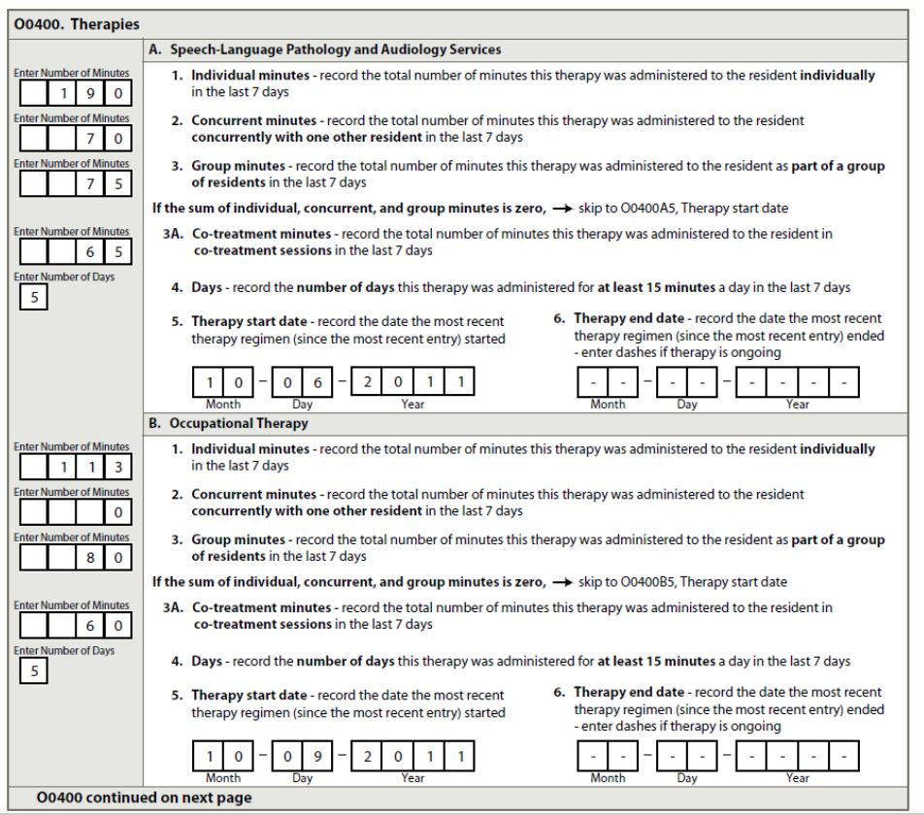
O0400: Therapies
Individual Minutes-total number of minutes
Concurrent minutes provided
Group minutes provided during
Co-treatment minutes
# Days resident received therapy
Therapy start date-evaluation date
Therapy end date-may be left blank if resident continues therapy
Therapy services and intellectual property provided by Functional Pathways. ©2022 All rights reserved. This information and materials were created by and is proprietary to Functional Pathways of Tennessee, LLC. Any unauthorized use, dissemination, distribution, or copying of this information and material, in whole or in part, is strictly prohibited.
Notes:
Concurrent-two treatments with residents doing two different activities
Group-2 or more residents performing the same activity

Slide 41
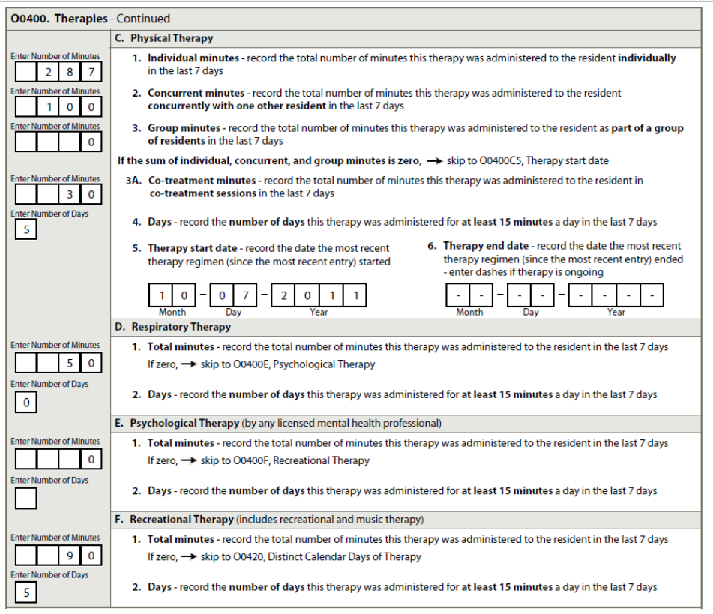
O0400: Therapies
Respiratory
Psychological Therapy
Recreational Therapy
Therapy services and intellectual property provided by Functional Pathways. ©2022 All rights reserved. This information and materials were created by and is proprietary to Functional Pathways of Tennessee, LLC. Any unauthorized use, dissemination, distribution, or copying of this information and material, in whole or in part, is strictly prohibited.

Slide 42
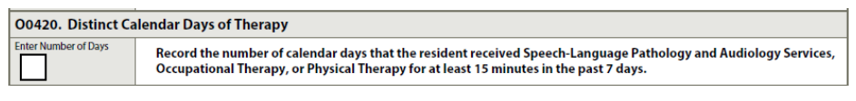
O0420-Distinct calendar Days of Therapy
# of days during the look back period or during the whole Med A stay that patient received ST, OT and PT services for at least 15 minutes.
Therapy services and intellectual property provided by Functional Pathways. ©2022 All rights reserved. This information and materials were created by and is proprietary to Functional Pathways of Tennessee, LLC. Any unauthorized use, dissemination, distribution, or copying of this information and material, in whole or in part, is strictly prohibited.

Slide 43
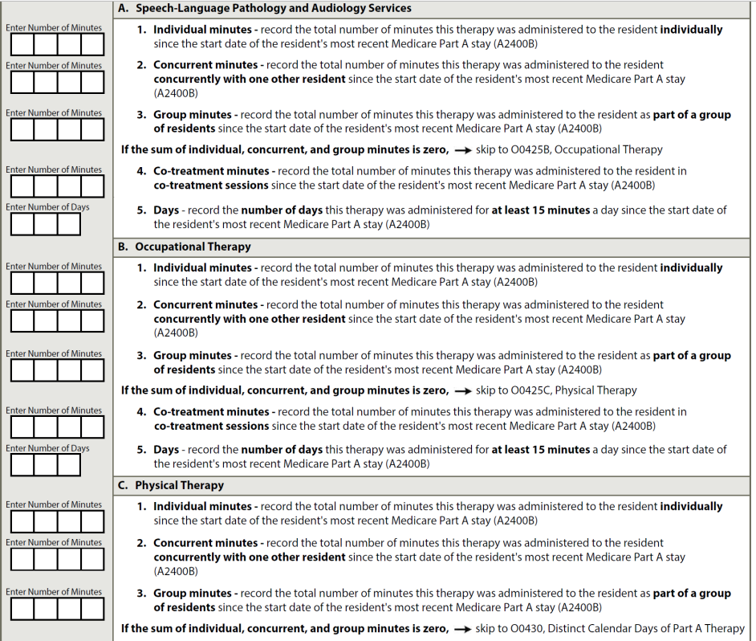
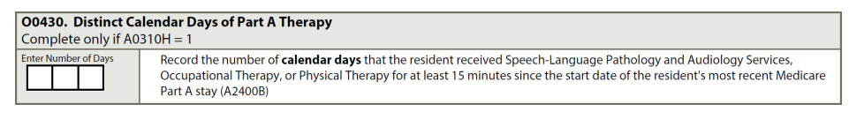
O0425-Part A Therapies/O0430-Distinct Calendar Days of Part A Therapy
Complete only if A0310H=1
Yes-SNF Part A PPS Discharge Assessment
Therapy services and intellectual property provided by Functional Pathways. ©2022 All rights reserved. This information and materials were created by and is proprietary to Functional Pathways of Tennessee, LLC. Any unauthorized use, dissemination, distribution, or copying of this information and material, in whole or in part, is strictly prohibited.
Notes:
Total number during the since the start date of care.

Slide 44
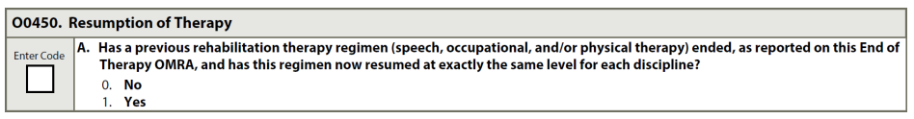
O0450: Resumption of Therapy
Some states require
Therapy services and intellectual property provided by Functional Pathways. ©2022 All rights reserved. This information and materials were created by and is proprietary to Functional Pathways of Tennessee, LLC. Any unauthorized use, dissemination, distribution, or copying of this information and material, in whole or in part, is strictly prohibited.

Slide 45
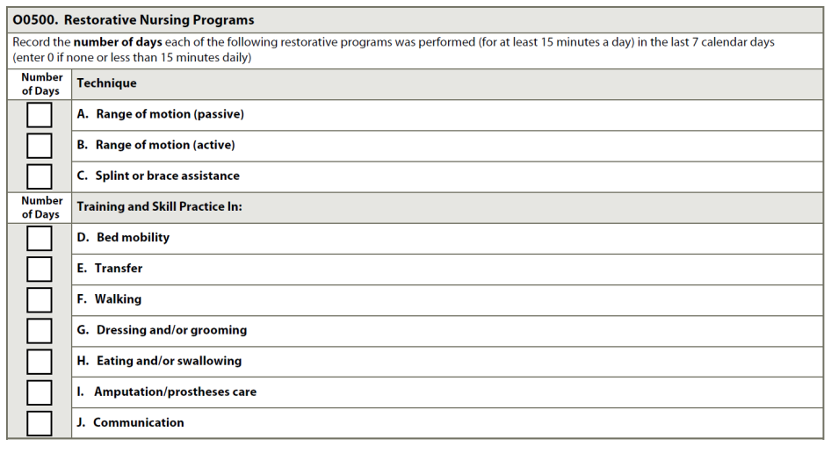
O0500-Restorative Nursing Program
Restorative nursing interventions that promote the ability to adapt and adjust to living as independently and safely as possible.
Physical, mental and psychosocial functioning
2 programs 15 or more minutes
6 days/week
Therapy services and intellectual property provided by Functional Pathways. ©2022 All rights reserved. This information and materials were created by and is proprietary to Functional Pathways of Tennessee, LLC. Any unauthorized use, dissemination, distribution, or copying of this information and material, in whole or in part, is strictly prohibited.
Notes:
This should and can be captured with therapy with our Med A patients. Need different goals for the resident between RNA/Therapy.
This will help with the end splits for the lower two Nursing Clinical Categories-Behavioral Symptoms or Cognitive Performance and Reduced Physical Function

Slide 46

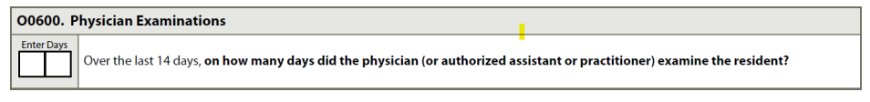
O0600: Physician Examination
Record the number of days that physician progress notes reflect that a physician examined the resident (or since admission if less than 14 days ago).
Includes medical doctors, doctors of osteopathy, podiatrists, dentists, and authorized physician assistants, nurse practitioners, or clinical nurse specialists working in collaboration with the physician as allowable by state law.
If the State does not require the completion of this item, use the standard “no information” code (a dash, “-”)
Therapy services and intellectual property provided by Functional Pathways. ©2022 All rights reserved. This information and materials were created by and is proprietary to Functional Pathways of Tennessee, LLC. Any unauthorized use, dissemination, distribution, or copying of this information and material, in whole or in part, is strictly prohibited.

Slide 47

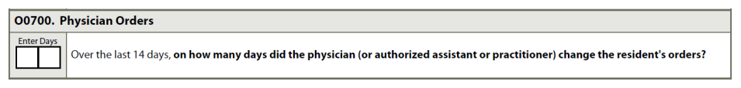
O0700: Physician Orders
Review the physician order sheets in the medical record.
Determine the number of days during the 14-day look-back period that a physician or other authorized practitioner allowable by State law changed the resident’s orders.
Enter the number of days during 14-day look-back period (or since admission, if less than 14 days ago) in which a physician changed the resident’s orders.
• If the State does not require the completion of this item, use the standard “no information” code a dash, “-”)
Therapy services and intellectual property provided by Functional Pathways. ©2022 All rights reserved. This information and materials were created by and is proprietary to Functional Pathways of Tennessee, LLC. Any unauthorized use, dissemination, distribution, or copying of this information and material, in whole or in part, is strictly prohibited.

Slide 48
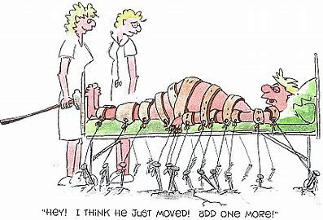
Section P:
Restraints and Alarms-Record the frequency that the resident was restrained by any of the listed devices at any time during the day or night.
Therapy services and intellectual property provided by Functional Pathways. ©2022 All rights reserved. This information and materials were created by and is proprietary to Functional Pathways of Tennessee, LLC. Any unauthorized use, dissemination, distribution, or copying of this information and material, in whole or in part, is strictly prohibited.

Slide 49
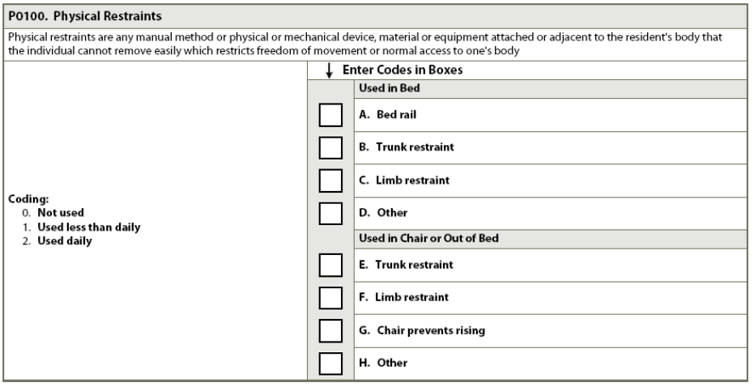
P0100-Physical Restraints
Therapy services and intellectual property provided by Functional Pathways. ©2022 All rights reserved. This information and materials were created by and is proprietary to Functional Pathways of Tennessee, LLC. Any unauthorized use, dissemination, distribution, or copying of this information and material, in whole or in part, is strictly prohibited.
Notes:
Any manual method or physical or mechanical device, material or equipment attached or adjacent to the resident’s body that the individual cannot remove easily, which restricts freedom of movement or normal access to one’s body.
Remove easily: manual method or physical or mechanical device, material or equipment can be removed intentionally by the resident in the same manner as it was applied by the staff. (side rail, buckle, knot, ties)
Freedom of movement: any change in place or position of the body or any part of the body that the person is physical able to control or access.

Slide 50
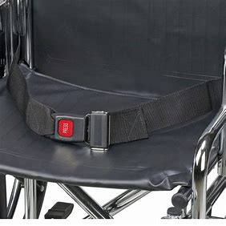
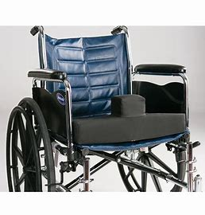
It Is Expected . . .
Restraint reduction/elimination→ Restraint Free Facilities
Therapy services and intellectual property provided by Functional Pathways. ©2022 All rights reserved. This information and materials were created by and is proprietary to Functional Pathways of Tennessee, LLC. Any unauthorized use, dissemination, distribution, or copying of this information and material, in whole or in part, is strictly prohibited.
Notes:
Restraints as a fall prevention approach-there is no evidence that the use of physical restraints will prevent, reduce or eliminate falls.

Slide 51
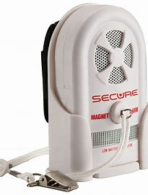
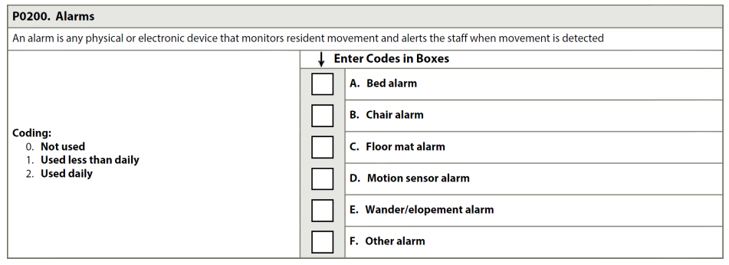

P0200: Alarms
Therapy services and intellectual property provided by Functional Pathways. ©2022 All rights reserved. This information and materials were created by and is proprietary to Functional Pathways of Tennessee, LLC. Any unauthorized use, dissemination, distribution, or copying of this information and material, in whole or in part, is strictly prohibited.
Notes:
An alarm is any physical or electronic device that monitors resident movement and alerts the staff, by either audible or inaudible means, when movement is detected, and may include bed, chair and floor sensor pads, cords that clip to the resident’s clothing, motion sensors, door alarms, or elopement/wandering devices.

Slide 52
Adverse Consequences of restraints and alarms
Fear
Anxiety
Dignity
Privacy
Infringement or freedom of movement
Agitation
Decreased mobility
Sleep disturbances
Therapy services and intellectual property provided by Functional Pathways. ©2022 All rights reserved. This information and materials were created by and is proprietary to Functional Pathways of Tennessee, LLC. Any unauthorized use, dissemination, distribution, or copying of this information and material, in whole or in part, is strictly prohibited.

Slide 53

Karen Welsh – VP of Clinical & Reimbursement - kwelsh@fprehab.com
Jen Callahan – Clinical & Reimbursement Specialist – jcallahan@fprehab.com
Beth Reigart – Clinical Program Specialist – breigart@fprehab.com
Melissa Brandt – Clinical & Reimbursement Specialist – mbrandt@fprehab.com
Therapy services and intellectual property provided by Functional Pathways. ©2022 All rights reserved. This information and materials were created by and is proprietary to Functional Pathways of Tennessee, LLC. Any unauthorized use, dissemination, distribution, or copying of this information and material, in whole or in part, is strictly prohibited.

