Slide 1

Functional Pathways
MDS Section GG

Slide 2

MDS Bootcamp: Section GG
Section G-Officially no longer a section for federally required assessments-BUT Section G did leave a little piece of itself behind-We will discuss what items came over to Section GG
Section GG-Functional Abilities and Goals
  Overview
  Changes
  Definitions
  Scoring
  Impact of Section GG
Therapy services and intellectual property provided by Functional Pathways. ©2022 All rights reserved. This information and materials were created by and is proprietary to Functional Pathways of Tennessee, LLC. Any unauthorized use, dissemination, distribution, or copying of this information and material, in whole or in part, is strictly prohibited.
Notes:
Week 3 of our MDS boot camp series and we couldn’t be happier to have you all along.
Now that Section G is officially removed from federal assessments- Remember, some of you may still have to use Section G for your Optional State Assessments (OSA), but for everyone else and for our purposes for this Boot Camp, Section G is no more.
Even though we went from talking about both Section G and GG to just Section GG here, there is still a plenty to cover- so Buckle up buttercup because we’ve got a long way to go and a short time to get there!

Slide 3

Section GG: Functional Abilities and Goals
Includes prior level of function, mobility device use, functional limitation in ROM, admission performance, discharge goals and discharge performance
Functional status is assessed based on need for assistance when performing self-care and mobility activities.
Information from this section is used for QMs, QRPs and soon will be VBP items as well.
3-day assessment period for each type of assessment (Admission, Interim, Discharge, OBRAs)
Therapy services and intellectual property provided by Functional Pathways. ©2022 All rights reserved. This information and materials were created by and is proprietary to Functional Pathways of Tennessee, LLC. Any unauthorized use, dissemination, distribution, or copying of this information and material, in whole or in part, is strictly prohibited.
Notes:
Section GG: Functional Abilities and Goals- here are the highlights- we will go into detail for each one of these pieces.
As we move through GG-pay attention to the lookback periods-

Slide 4
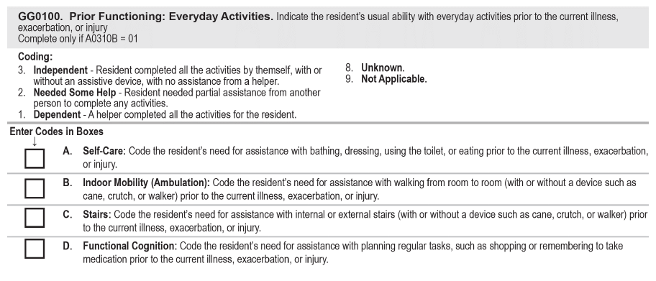
Section GG0100: Prior Functioning: Everyday Activities
Knowledge of the resident’s functioning prior to current illness, exacerbation or injury may help to establish treatment goals.
Therapy services and intellectual property provided by Functional Pathways. ©2022 All rights reserved. This information and materials were created by and is proprietary to Functional Pathways of Tennessee, LLC. Any unauthorized use, dissemination, distribution, or copying of this information and material, in whole or in part, is strictly prohibited.
Notes:
Code resident’s usual ability to perform self care, indoor mobility (ambulation), stairs, functional cognition prior to current illness...
Not wiggle room here-if they needed any help at all, have to code needed some help
Can ask resident or family, review med rec

Slide 5
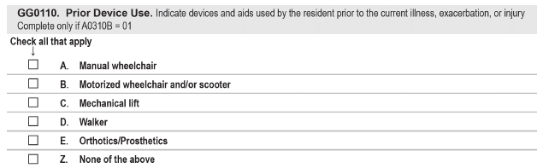
Section GG0110: Prior Device Use
Knowledge of the resident’s use of devices/aids prior to current illness, exacerbation or injury may help to establish treatment goals.
Therapy services and intellectual property provided by Functional Pathways. ©2022 All rights reserved. This information and materials were created by and is proprietary to Functional Pathways of Tennessee, LLC. Any unauthorized use, dissemination, distribution, or copying of this information and material, in whole or in part, is strictly prohibited.
Notes:
Code all devices res used prior to current
May ask resident, family, med rec review

Slide 6
Section GG0115:Functional Limitation in Range of Motion (ROM)
Functional impairment could place the resident at risk of injury or interfere with ADLS
Functional Limitation in ROM=Limited ability to move a joint that affects function
Code for presence or absence of functional limitation in both upper and lower extremities based on steps for assessment
  Upper extremities are shoulder, elbow, wrist and hand.
  Lower extremities are Hip, knee, ankle, foot
**Coding tip: Do not look at limited ROM in isolation, but determine whether the limited ROM impacts function or places resident at increased risk of injury
Therapy services and intellectual property provided by Functional Pathways. ©2022 All rights reserved. This information and materials were created by and is proprietary to Functional Pathways of Tennessee, LLC. Any unauthorized use, dissemination, distribution, or copying of this information and material, in whole or in part, is strictly prohibited.
Notes:
This is an item that was newly added to Section GG as of 10/1/23- came over from Section G- instructions and intent has not changed.
The RAI does a great job of explaining steps for assessment of these items-

Slide 7
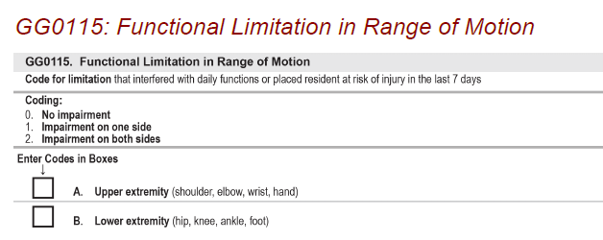
Section GG0115:Functional Limitation in Range of Motion (ROM)
For coding-the RAI states to refer to items in GG0130- the self care GGs and GG0170-the mobility GGs in order to see any limitation in ROM and whether it affects their functional ability to complete those tasks.
Therapy services and intellectual property provided by Functional Pathways. ©2022 All rights reserved. This information and materials were created by and is proprietary to Functional Pathways of Tennessee, LLC. Any unauthorized use, dissemination, distribution, or copying of this information and material, in whole or in part, is strictly prohibited.
Notes:
This is an item that was newly added to Section GG as of 10/1/23- came over from Section G- instructions and intent was not changed.
This item has a 7-day lookback for determining range of motion limitation
Coding for functional ROM limitations is a three-step process:
1. Test the resident’s upper and lower extremity ROM (See item 6 below for examples).
2. If the resident is noted to have limitation of upper- and/or lower-extremity ROM, review GG0130 and GG0170 and/or directly observe the resident to
3. determine whether the limitation interferes with function or places the resident at risk for injury.
Code GG0115A and GG0115B as appropriate based on the above assessment.
The RAI does a great job of explaining steps for testing the resident’s ROM and completing the assessment of these items-

Slide 8
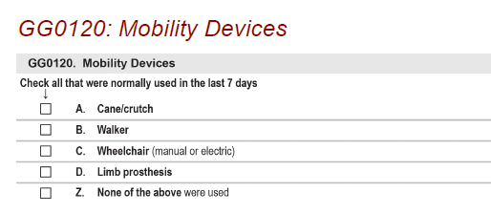
Section GG0120: Mobility Devices
Use of mobility devices can allow a resident to maintain independence in function
Check all that apply- devices used in last 7 days
Therapy services and intellectual property provided by Functional Pathways. ©2022 All rights reserved. This information and materials were created by and is proprietary to Functional Pathways of Tennessee, LLC. Any unauthorized use, dissemination, distribution, or copying of this information and material, in whole or in part, is strictly prohibited.
Notes:
Careful not to confuse this with the “Prior Device” item in GG0110
Take notice-devices normally used in the last 7 days

Slide 9
Section GG: Functional Abilities and Goals
GG0130 (Self-Care) and GG0170 (Mobility)
  3-day assessment period-admission, d/c, and interim/OBRAs
  Meant to determine resident’s “usual performance” during 3 day assessment
  Uses a 6-point scale
  Additional scale if the activity was not attempted
  Each item has definition of what to include and exclude in assessment
  Assess each item based on direct observation, self-reports, and reports from staff, family, qualified clinicians documented during 3-day assessment period
  Allow resident to perform activities as independently as safely possible
  Understand definition of “helper” for purposes of coding Section GG (next slide)
  Activities may be completed with or without assistive device
Therapy services and intellectual property provided by Functional Pathways. ©2022 All rights reserved. This information and materials were created by and is proprietary to Functional Pathways of Tennessee, LLC. Any unauthorized use, dissemination, distribution, or copying of this information and material, in whole or in part, is strictly prohibited.
Notes:
You have 3 days, with day of admission counting as day 1, so if resident gets to your facility at 11pm on Tuesday, Tuesday is day 1, wed day 2 and Thursday day 3
The requirement for at least one d/c goal has been removed and is no longer a requirement

Slide 10
Section GG: Functional Abilities and Goals
Self-Care and Mobility Coding
“Helper” for purposes of completing Section GG:
  Facility staff who are direct employees
  Facility-contracted employees (such as therapists, agency staff etc.)
It does not include :
    individuals hired by persons outside facility management and administration
    hospice staff
    family hired caregiver
    nursing and/or therapy students
    volunteers
    friends or family
*When helper assistance is required because a resident’s performance is unsafe or of poor quality, only consider facility staff when scoring according to amount of assistance provided.
Therapy services and intellectual property provided by Functional Pathways. ©2022 All rights reserved. This information and materials were created by and is proprietary to Functional Pathways of Tennessee, LLC. Any unauthorized use, dissemination, distribution, or copying of this information and material, in whole or in part, is strictly prohibited.

Slide 11
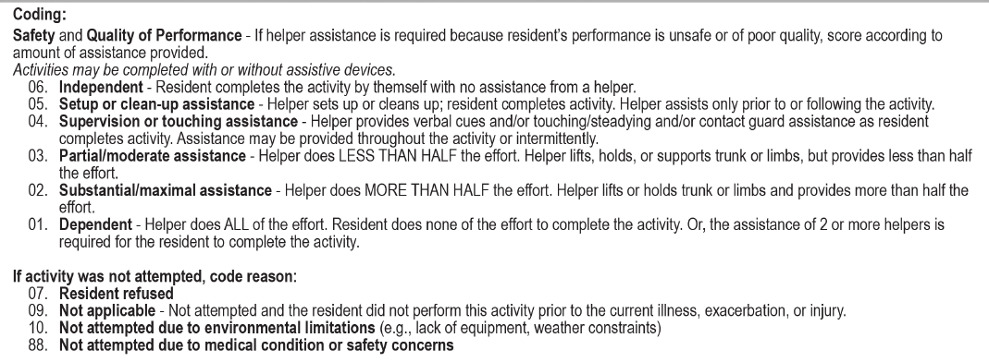
Section GG: Functional Abilities and Goals
Self-Care and Mobility Coding (cont’d)
Therapy services and intellectual property provided by Functional Pathways. ©2022 All rights reserved. This information and materials were created by and is proprietary to Functional Pathways of Tennessee, LLC. Any unauthorized use, dissemination, distribution, or copying of this information and material, in whole or in part, is strictly prohibited.
Notes:
The coding is the same for both Self-Care and Mobility GG items and is also the same across assessments

Slide 12
Section GG: Functional Abilities and Goals
Self-Care and Mobility Coding-(cont’d)
Usual Performance
  A resident’s functional status can be impacted by the environment or situations encountered at the facility.
  Observing the resident’s interactions with others in different locations and circumstances is important for a comprehensive understanding of the resident’s functional status.
  If the resident’s functional status varies, record the resident’s usual ability to perform each activity.
  Do not record the resident’s best performance and do not record the resident’s worst performance, but rather record the resident’s usual performance.
Therapy services and intellectual property provided by Functional Pathways. ©2022 All rights reserved. This information and materials were created by and is proprietary to Functional Pathways of Tennessee, LLC. Any unauthorized use, dissemination, distribution, or copying of this information and material, in whole or in part, is strictly prohibited.

Slide 13
Section GG: Functional Abilities and Goals
Self-Care and Mobility Coding-(cont’d)
Usual Performance
If the resident performs the activity more than once during the assessment period and the resident’s performance varies, coding in Section GG is based on the resident’s “usual performance,” which is identified as the resident’s usual activity/performance for any of the Self-Care or Mobility activities, not the most independent or dependent performance over the assessment period. A provider may need to use the entire three-day assessment period to obtain the resident’s usual performance.
Therapy services and intellectual property provided by Functional Pathways. ©2022 All rights reserved. This information and materials were created by and is proprietary to Functional Pathways of Tennessee, LLC. Any unauthorized use, dissemination, distribution, or copying of this information and material, in whole or in part, is strictly prohibited.

Slide 14
Section GG: Functional Abilities and Goals
Self-Care and Mobility: General Coding Tips
  Be familiar with the definition of each activity
  If activity not attempted during assessment period, code the reason using appropriate code
  If 2 or more helpers are needed for the resident to complete activity safely, code 01, dependent
  Use of a dash (-) indicates no information-CMS expects this to be a rare occurrence
Therapy services and intellectual property provided by Functional Pathways. ©2022 All rights reserved. This information and materials were created by and is proprietary to Functional Pathways of Tennessee, LLC. Any unauthorized use, dissemination, distribution, or copying of this information and material, in whole or in part, is strictly prohibited.
Notes:
Just some general coding tips here- straight from the RAI

Slide 15
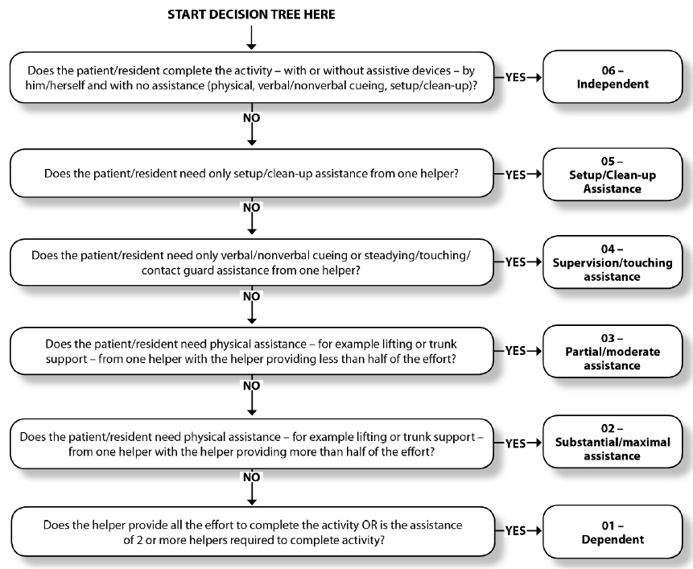
Section GG: Functional Abilities and Goals
Therapy services and intellectual property provided by Functional Pathways. ©2022 All rights reserved. This information and materials were created by and is proprietary to Functional Pathways of Tennessee, LLC. Any unauthorized use, dissemination, distribution, or copying of this information and material, in whole or in part, is strictly prohibited.
Notes:
Decision tree from RAI

Slide 16





Section GG0130: Self-Care Items Definitions
GG0130A: Eating
  Ability to use suitable utensils to bring food and/or liquid to the mouth and swallow food/liquid once meal is placed before the resident
GG0130B: Oral Hygiene
  Ability to use suitable items to clean teeth.
  Dentures (if applicable)the ability to insert and remove dentures into and from the mouth and manage denture soaking and rinsing with use of equipment.
GG0130C: Toileting Hygiene
  Ability to maintain perineal hygiene, adjust clothes before and after voiding or having bowel movement.
  If managing an ostomy, include wiping the opening but not managing the equipment.
GG0130E: Shower/bathe self
  Ability to wash, rinse, and dry the face, upper/lower body, perineal area, and feet
  Exclude washing, rinsing, and drying the resident’s back and hair
  Exclude transfer in/out of tube and shower
Therapy services and intellectual property provided by Functional Pathways. ©2022 All rights reserved. This information and materials were created by and is proprietary to Functional Pathways of Tennessee, LLC. Any unauthorized use, dissemination, distribution, or copying of this information and material, in whole or in part, is strictly prohibited.
Notes:
Let’s get into the Self-Care items first- as this is the order on the MDS
Notice the ones with the stars- QM is Quality measure FS is Function Score
These first 3 items-Eating, Oral Hygiene and Toileting Hygiene all count toward the PT/OT FS, and Eating and Toileting Hygiene both count toward Nsg FS. Each of these are “whole” items when it comes to the FS calculation, that is they are not averaged together with any other GG items to come up with a FS like Bed Mobility, transfers and the ambulation items are.
Eating is also considered late loss ADLs and part of a calculation used for the QM increased help with ADLs-

Slide 17


Section GG0130: Self-Care Items Definitions (cont’d)
GG0130F: Upper body dressing
  Ability to dress and undress above the waist (bra, undershirt, t-shirt, button down, dress, pajama)
  Includes fasteners (TLSO, back brace, abdominal binder, sling, prosthesis)
GG0130G: Lower body dressing
  Ability to dress and undress below the waist (underwear, incontinence brief, pants, shorts, skirt)
  Includes fasteners (knee brace, elastic bandage, stump shrinker, prosthesis)
GG0130H: Putting on/taking off footwear
  Ability to put on and take off socks and shoes or other footwear that is appropriate for safe mobility (socks, shoes, boots)
  Includes fasteners (AFO, foot orthotic, walking boots, compression stockings)
GG0130I: Personal Hygiene
  Ability to maintain personal hygiene
  Includes combing hair, shaving, applying makeup, washing/drying face and hands (excludes baths, showers and oral hygiene)
Therapy services and intellectual property provided by Functional Pathways. ©2022 All rights reserved. This information and materials were created by and is proprietary to Functional Pathways of Tennessee, LLC. Any unauthorized use, dissemination, distribution, or copying of this information and material, in whole or in part, is strictly prohibited.
Notes:
New item added here 10/1/23 from Section G-personal hygiene

Slide 18
Section GG0130: Self-Care Coding Tips
  GG0130A: Eating
    Administration of tube feedings is not considered when coding this activity
    If resident gets 100% of nutrition through non oral means because of new/recent onset of a medical condition, you will code 88-not attempted due to medical or safety concerns
    If resident gets 100% of nutrition through non oral means and did not eat/drink by mouth previous to current illness, you will code 09-not applicable, and the resident did not perform this activity prior to current illness.
    If resident eats/drinks some things by mouth, you would code Eating based on the amount of assistance needed when eating and drinking by mouth
Therapy services and intellectual property provided by Functional Pathways. ©2022 All rights reserved. This information and materials were created by and is proprietary to Functional Pathways of Tennessee, LLC. Any unauthorized use, dissemination, distribution, or copying of this information and material, in whole or in part, is strictly prohibited.

Slide 19
Section GG0130: Self-Care Coding Tips
  GG0130B Oral Hygiene: If resident does not perform oral hygiene during therapy, determine resident’s abilities based on performance in the nursing care unit.
    For a resident who is edentulous, code Oral hygiene based on the type and amount of assistance required from a helper to clean the resident’s gums.
  GG0130C Toileting Hygiene: Includes managing undergarments, clothing and incontinence products and performing perineal cleansing before and after voiding.
    If resident does not usually use undergarments, then assess need for assistance to manage lower body clothing and perineal hygiene
    If resident completes toileting program in bed, code based on the residents need for assistance with managing clothing and perineal cleansing
    If resident has indwelling catheter and has bowel movements, code based on amount of assistance needed by resident before and after moving their bowels.
Therapy services and intellectual property provided by Functional Pathways. ©2022 All rights reserved. This information and materials were created by and is proprietary to Functional Pathways of Tennessee, LLC. Any unauthorized use, dissemination, distribution, or copying of this information and material, in whole or in part, is strictly prohibited.

Slide 20
Section GG0130: Self-Care Coding Tips
  GG0130E Shower/bathe self: includes ability to wash, rinse, and dry the face, upper and lower body, perineal area and feet. Do not include washing, rinsing, drying back or hair. Does not include transfer in/out of tub/shower.
    Assessment can take place in shower or bath or at a sink (i.e., full body sponge bath)
    If resident bathes themselves and a helper sets up materials for bathing/showering, then code 05, Setup or clean-up assistance
    If resident cannot bathe their entire body due to medical condition, then code based on amount of assistance needed to complete activity
Therapy services and intellectual property provided by Functional Pathways. ©2022 All rights reserved. This information and materials were created by and is proprietary to Functional Pathways of Tennessee, LLC. Any unauthorized use, dissemination, distribution, or copying of this information and material, in whole or in part, is strictly prohibited.

Slide 21
Section GG0130: Self-Care Coding Tips
  GG0130F/G/H Upper body dressing, Lower body dressing, Putting on/taking off footwear:
    If resident dresses themselves and a helper retrieves or puts away clothing, code 05 Setup/Clean up
    When coding upper/lower body dressing, helper assist with buttons/fasteners is considered touching assistance-04
    If donning/doffing elastic bandages, stockings, orthosis or prosthesis occurs while dressing, then count these items as clothing when determining amount of assistance needed.
    Make sure you understand what clothing items are included in each activity. Ex. Upper body includes bra, undershirt, shirts, nightgown, etc. Lower body includes underwear, incontinence brief, pants, shorts, skirts, etc. Footwear includes socks, shoes, etc.
Therapy services and intellectual property provided by Functional Pathways. ©2022 All rights reserved. This information and materials were created by and is proprietary to Functional Pathways of Tennessee, LLC. Any unauthorized use, dissemination, distribution, or copying of this information and material, in whole or in part, is strictly prohibited.
Notes:
Code resident’s usual performance and discharge goal

Slide 22
Section GG0130: Self-Care Coding Tips
  GG0130 I Personal Hygiene:
    Personal hygiene involves the ability to maintain personal hygiene, including combing hair, shaving, applying makeup, and washing and drying face and hands (excludes baths, showers, and oral hygiene).
Therapy services and intellectual property provided by Functional Pathways. ©2022 All rights reserved. This information and materials were created by and is proprietary to Functional Pathways of Tennessee, LLC. Any unauthorized use, dissemination, distribution, or copying of this information and material, in whole or in part, is strictly prohibited.
Notes:
They didn’t really give any coding tips here perse in the RAI- just gave the definition over again…

Slide 23

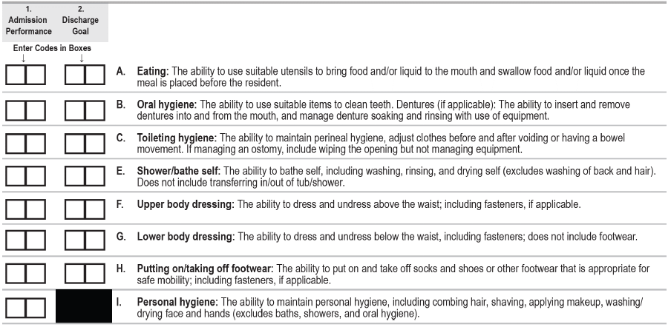
Section GG0130: Self-Care Admission
Therapy services and intellectual property provided by Functional Pathways. ©2022 All rights reserved. This information and materials were created by and is proprietary to Functional Pathways of Tennessee, LLC. Any unauthorized use, dissemination, distribution, or copying of this information and material, in whole or in part, is strictly prohibited.
Notes:
Column 1-Admission performance needs to be completed when the assessment is an admission assessment.
For column 2- Discharge Goals for Self Care items: this is no longer required as part of the 100% of 90% QRP, (even though it still says it in the RAI) as of 10/1/23, no discharge goal is needed
I have provided a quote on the next slide for the D/C goals not being needed…

Slide 24
From the bottom of the Skilled Nursing Facility Quality Reporting Program APU Document affecting FY 2026:
“+ Beginning October 1, 2023, at least one GG0130, Self-care, or GG0170, Mobility, discharge goal item is not required to be coded to fulfill requirements of the SNF QRP. CMS plans to remove the Self-Care Discharge Goals (that is, GG0130, Column 2) and Mobility Discharge Goals (that is, GG0170, Column 2) with the next release of the MDS. However, SNFs will continue to receive an APU warning if a MDS is submitted to iQIES without at least one self-care or mobility discharge goal. SNFs can ignore this warning and proceed with submitting their assessment.”
Therapy services and intellectual property provided by Functional Pathways. ©2022 All rights reserved. This information and materials were created by and is proprietary to Functional Pathways of Tennessee, LLC. Any unauthorized use, dissemination, distribution, or copying of this information and material, in whole or in part, is strictly prohibited.

Slide 25
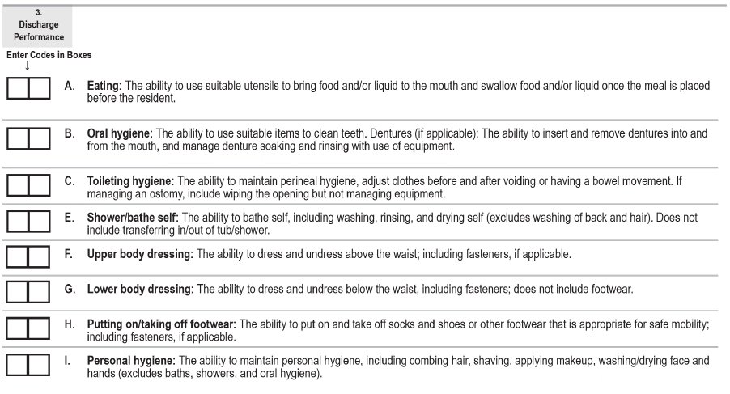
Section GG0130: Self-Care Discharge
  3 day assessment period-last 3 days of the SNF PPS stay ending on A2400C OR last 3 days in facility for OBRA Discharge ending A2000
  Meant to determine resident’s “usual performance” during those 3 days
Therapy services and intellectual property provided by Functional Pathways. ©2022 All rights reserved. This information and materials were created by and is proprietary to Functional Pathways of Tennessee, LLC. Any unauthorized use, dissemination, distribution, or copying of this information and material, in whole or in part, is strictly prohibited.
Notes:
Again same items as admission assessment
Day of discharge and 2 previous days.
Code resident’s usual performance over last 3 days of stay/ PPS stay
Discharge items are considered column 3

Slide 26
Section GG0130: Self-Care Discharge
If the End Date of Most Recent Medicare Stay (A2400C) occurs on the day of or one day before the Discharge Date (A2000), the OBRA Discharge assessment and Part A PPS Discharge assessment are both required and must be combined.
When the OBRA and Part A PPS Discharge assessments are combined, the ARD (A2300) must be equal to the Discharge Date (A2000).
Therapy services and intellectual property provided by Functional Pathways. ©2022 All rights reserved. This information and materials were created by and is proprietary to Functional Pathways of Tennessee, LLC. Any unauthorized use, dissemination, distribution, or copying of this information and material, in whole or in part, is strictly prohibited.
Notes:
One last little thing here-

Slide 27
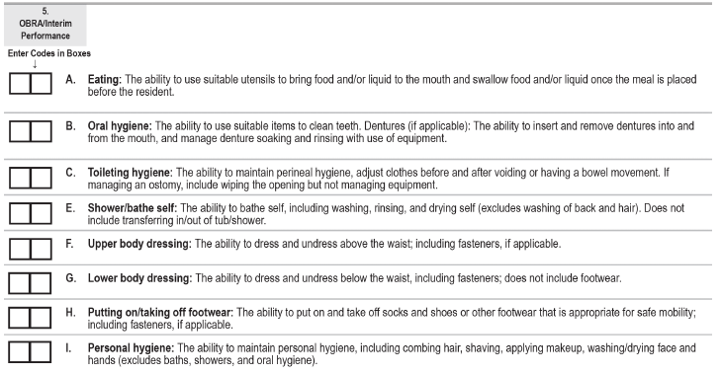
Section GG0130: Self-Care OBRA/Interim
  Meant to determine resident’s “usual performance” during those 3 days
  Uses same 6-point/Activity not attempted coding
  No boxes for entering update discharge goals
Therapy services and intellectual property provided by Functional Pathways. ©2022 All rights reserved. This information and materials were created by and is proprietary to Functional Pathways of Tennessee, LLC. Any unauthorized use, dissemination, distribution, or copying of this information and material, in whole or in part, is strictly prohibited.
Notes:
Same items for self-care as Admission and D/C assessments
3 day assessment = ARD and 2 days prior
They have combined this column-5 to cover both IPA’s and OBRA assessments- when for an IPA its intent is the same as it has been- to update the PDPM reimbursement due to a change in condition-always optional-

Slide 28

Section GG: Mobility Items Definitions
GG0170A: Roll left and right
  Ability to roll from lying on back to left/right side, and return to lying on back on the bed
  Clinical judgement should be used to determine what is considered lying on back
GG0170B: Sit to Lying
  Ability to move from sitting on side of bed to lying flat on bed
GG0170C: Lying to sitting on side of bed
  The ability to move from lying on the back to sitting on the side of the bed with no back support
GG0170D: Sit to Stand
  The ability to come to a standing position from sitting in chair, wheelchair, or pn the side of the bed.
GG0170E: Chair/bed-to-chair transfer
  The ability to transfer to and from a bed to a chair (or wheelchair)
Therapy services and intellectual property provided by Functional Pathways. ©2022 All rights reserved. This information and materials were created by and is proprietary to Functional Pathways of Tennessee, LLC. Any unauthorized use, dissemination, distribution, or copying of this information and material, in whole or in part, is strictly prohibited.
Notes:
Same with the stars here as with the self-care info- QM is for Quality Measure and FS is for Function Score
Sit to lying and Sit to stand are both part of the long stay QM- % residents whose need for help with Late loss ADL s increased
Sit to lying and Lying to sitting on side of bed-used to average together to calculate bed mobility FS for both PT/OT and Nursing;
Sit to stand, chair to bed and toilet transfers averaged together to calculate transfer FS again for both PT/OT and Nsg

Slide 29


Section GG: Mobility Items Definitions (cont’d)
GG0170F: Toilet Transfer
  Ability to get on and off a toilet or commode
GG0170FF: Tub/Shower Transfer
  Ability to get in/out of tub/shower
GG0170G: Car Transfer
  Ability to transfer in/out of a car or van on passenger side
  Excludes ability to open/close door or fasten seat belt
GG0170I: Walk 10 feet
  Once standing, ability to walk at least 10ft in a room, corridor, or similar space
  Skip pattern: Skip to GG0170M: 1 step if performance coded 07, 09, 10, 88
GG0170J: Walk 50’ with two turns
  Once standing, the ability to walk at least 50 feet and make two turns
GG0170K: Walking 150 feet:
  Once standing, ability to walk 150ft in a corridor or similar space
Therapy services and intellectual property provided by Functional Pathways. ©2022 All rights reserved. This information and materials were created by and is proprietary to Functional Pathways of Tennessee, LLC. Any unauthorized use, dissemination, distribution, or copying of this information and material, in whole or in part, is strictly prohibited.
Notes:
Toilet transfer is the final late loss ADL used in the LS quality measure -% of residents whose need for help with late loss ADLs increased and is used to average in with the other 2 transfers for the Function Score calculation
The walk 10’ item is used for the updated LS QM- % residents whose ability to walk Independently worsened
Finally the 2 ambulation items here are used to average and calculate that FS for PT/OT only

Slide 30
Section GG: Mobility Items Definitions (cont’d)
GG0170L: Walking 10 feet on uneven surfaces
  Once standing, ability to walk 10ft on uneven or sloping surfaces (indoor or outdoor)
  Turf and gravel considered uneven
GG0170M: 1 Step (curb)
  Ability to go up/down a curb and/or up/down one step
  Task can be attempted with or without a rail
  Skip pattern: Skip to GG0170P: Picking up objects if performance coded 07, 09, 10, 88
GG0170N: 4 Steps
  Ability to go up/down four step
  Task can be attempted with or without a rail
  Skip pattern: Skip to GG0170P: Picking up objects if performance coded 07, 09, 10, 88
GG0170O: 12 Steps
  Ability to go up/down twelve steps
  Task can be attempted with or without a rail
  RAI has updated this to say that completion of 4 steps 3 times will satisfy this item
Therapy services and intellectual property provided by Functional Pathways. ©2022 All rights reserved. This information and materials were created by and is proprietary to Functional Pathways of Tennessee, LLC. Any unauthorized use, dissemination, distribution, or copying of this information and material, in whole or in part, is strictly prohibited.

Slide 31
Section GG: Mobility Items Definitions (cont’d)
GG0170P: Picking up object
  Ability to bend/stoop from a standing position to pick up small object from the floor (spoon, pencil)
GG0170Q1: Does the resident use a wheelchair and/or scooter?
  Skip pattern: if 0. No, Skip to GG0130, Self Care (discharge)
  If 1. yes, continue to GG0170R
GG0170R: Wheel 50’ with 2 turns
  Once seated in wheelchair/scooter, the ability to wheel at least 50’ and make 2 turns
  Turns have to be 90 degree turns
  GG0170RR1: Indicate type of wheelchair or Scooter-1. Manual 2. Motorized
GG0170S: Wheel 150’
  Once seated in wheelchair/scooter, the ability to wheel at least 150’ in corridor or similar space
GG0170SS1: Indicate type of wheelchair or Scooter-1. Manual 2. Motorized
Therapy services and intellectual property provided by Functional Pathways. ©2022 All rights reserved. This information and materials were created by and is proprietary to Functional Pathways of Tennessee, LLC. Any unauthorized use, dissemination, distribution, or copying of this information and material, in whole or in part, is strictly prohibited.
Notes:
If the resident is not able to stand, the activity did not occur, and the appropriate “not attempted” code would be used.

Slide 32
Section GG: Mobility Coding Tips
GG0170C: Lying to sitting on side of bed: Includes transitions from lying on their back to sitting on side of bed and sitting upright on the bed without back support.
If the resident does not sleep in a bed, clinicians should assess bed mobility activities using the alternative furniture on which the resident sleeps (for example, a recliner).
  Clinical judgement should be used for what is considered “lying” position for a resident
  Back support-any object/person providing support for back
  If bed mobility cannot be assessed due to having head of bed elevated for a medical condition, GG0170A Roll left and right, GG0170B Sit to lying, GG0170C lying to sit would all be coded 88
GG0170D: Sit to stand: If sit to stand lift is used and 2 helpers are needed to assist with the lift, code 01, Dependent
  The activity includes the resident coming to a standing position from any sitting surface.
  If a full-body mechanical lift is used to assist in transferring a resident for a chair/bed-to-chair transfer, code GG0170D, Sit to stand with the appropriate “activity not attempted” code.
  Code as 05, Setup or clean-up assistance, if the only help a resident requires to complete the sit-to-stand activity is for a helper to retrieve an assistive device or adaptive equipment, such as a walker or ankle-foot orthosis.
Therapy services and intellectual property provided by Functional Pathways. ©2022 All rights reserved. This information and materials were created by and is proprietary to Functional Pathways of Tennessee, LLC. Any unauthorized use, dissemination, distribution, or copying of this information and material, in whole or in part, is strictly prohibited.

Slide 33
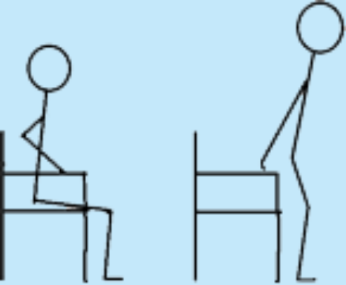
Section GG: Mobility Coding Tips
GG0170E: Chair/bed to chair transfer: Begins with resident sitting in upright position on one surface and returning to sitting in upright position to another surface
  Depending on the resident’s abilities, the transfer may be a stand-pivot, squat-pivot, or a slide board transfer.
  If a mechanical lift is used to assist in transferring a resident for a chair/bed-to-chair transfer and two helpers are needed to assist with the mechanical lift transfer, then code as 01, Dependent, even if the resident assists with any part of the chair/bed-to-chair transfer.
GG0170F: Toilet transfers: the ability to get on and off commode
  If resident uses bedpan due to medical condition, code 88
  Code as 05, Setup or clean-up assistance, if the resident requires a helper to position/set up the bedside commode before and/or after the resident’s bed-to-commode transfers (place at an accessible angle/location next to the bed) and the resident does not require helper assistance during Toilet transfers.
Therapy services and intellectual property provided by Functional Pathways. ©2022 All rights reserved. This information and materials were created by and is proprietary to Functional Pathways of Tennessee, LLC. Any unauthorized use, dissemination, distribution, or copying of this information and material, in whole or in part, is strictly prohibited.
Notes:
CTBTC: When possible, the transfer should be assessed in an environmental situation in which taking more than a few steps would not be necessary to complete the transfer.
Toileting hygiene, clothing management, and transferring on and off a bedpan are not considered part of the Toilet transfer activity.

Slide 34
Section GG: Mobility Coding Tips
GG0170FF: Tub/shower transfer: includes ability to get in and out of tub or shower-do not include washing, rinsing or drying
GG0170G: Car transfer: ability to transfer in and out of a car or van on the passenger side
  Use of indoor car can be used as long as similar features of a real car
  Does not include transfers to driver’s seat, opening/closing door, fastening/ unfastening seatbelt
GG0170I-L: Walking Items: Walk 10 feet, Walk 50 feet with 2 turns, Walk 150 feet
  Walking activities do not need to occur during one session.
  When coding these items do not use parallel bars
  Turns in GG0170J, Walk 50 feet with 2 turns are 90 degree turns; may be in the same or different direction
Therapy services and intellectual property provided by Functional Pathways. ©2022 All rights reserved. This information and materials were created by and is proprietary to Functional Pathways of Tennessee, LLC. Any unauthorized use, dissemination, distribution, or copying of this information and material, in whole or in part, is strictly prohibited.

Slide 35
Section GG: Mobility Coding Tips
GG0170M-O: Step Items: 1 step, 4 steps and 12 steps
  If a resident’s environment does not have 12 steps, the combination of going up and down 4 stairs three times consecutively in a safe manner is an acceptable alternative to comply with the intention and meet the requirements of this activity.
GG0170P: Picking up and Object: includes resident stooping or bending from a standing position to pick up a small object, such as a spoon.
  Picking up the object must be assessed while the resident is in a standing position. If the resident is not able to stand, the activity did not occur, and the appropriate “not attempted” code would be used.
  Assistive devices and adaptive equipment may be used, for example, a cane to support standing balance and/or a reacher to pick up the object.
Therapy services and intellectual property provided by Functional Pathways. ©2022 All rights reserved. This information and materials were created by and is proprietary to Functional Pathways of Tennessee, LLC. Any unauthorized use, dissemination, distribution, or copying of this information and material, in whole or in part, is strictly prohibited.

Slide 36
Section GG: Mobility Coding Tips
GG0170R and GG0170S: Wheelchair Items: Intent of these items is to assess ability of residents who are learning how to self mobilize using a wheelchair or who used a wheelchair prior to admission
  Do not code w/c mobility if resident uses wheelchair only when transported between locations within the facility or for staff convenience
  If resident walks and only uses wheelchair when transported/for staff convenience as above, code the gateway items (GG0170Q1 and/or GG0170Q3, “Does resident use a wheelchair/scooter?” as 0, No and skip all remaining wheelchair questions.
    Example: a resident is transported by staff/family between their room and the dining room or therapy, but the resident is not expected to use a wheelchair after discharge.
  The turns included in GG0170R are 2 90-degree turns.
Therapy services and intellectual property provided by Functional Pathways. ©2022 All rights reserved. This information and materials were created by and is proprietary to Functional Pathways of Tennessee, LLC. Any unauthorized use, dissemination, distribution, or copying of this information and material, in whole or in part, is strictly prohibited.
Notes:
Code resident’s usual performance and discharge goal

Slide 37
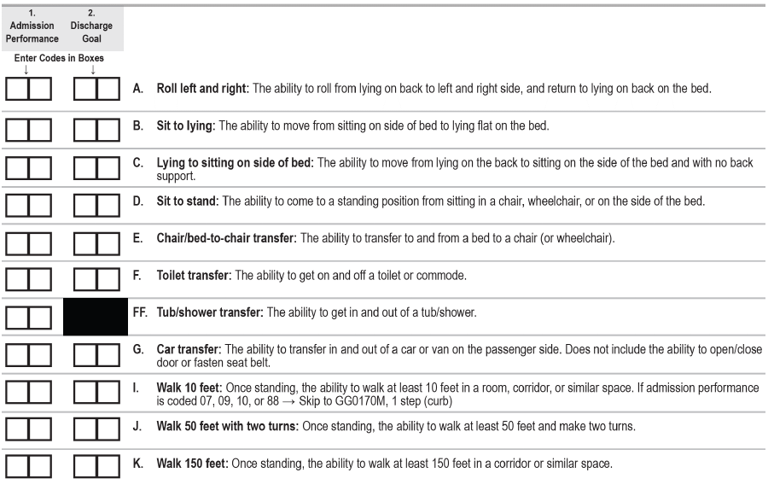
Section GG0170: Mobility Admission
Therapy services and intellectual property provided by Functional Pathways. ©2022 All rights reserved. This information and materials were created by and is proprietary to Functional Pathways of Tennessee, LLC. Any unauthorized use, dissemination, distribution, or copying of this information and material, in whole or in part, is strictly prohibited.
Notes:
This is what it looks like in MDS-these are the items we just reviewed same rules as we went over for Self-Care items in these assessments applies to mobility items-remember that d/c goal is no longer required- I included the same quote from earlier after these items.

Slide 38
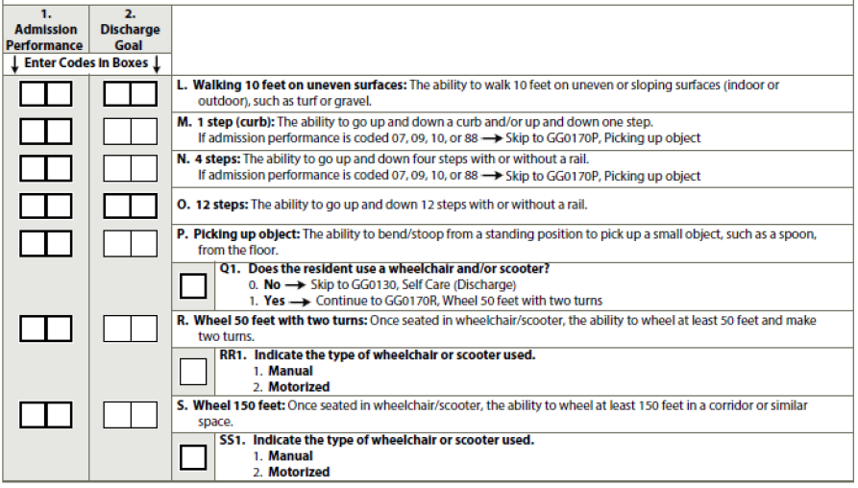
Section GG0170: Mobility Admission (cont’d)
Therapy services and intellectual property provided by Functional Pathways. ©2022 All rights reserved. This information and materials were created by and is proprietary to Functional Pathways of Tennessee, LLC. Any unauthorized use, dissemination, distribution, or copying of this information and material, in whole or in part, is strictly prohibited.

Slide 39
From the bottom of the Skilled Nursing Facility Quality Reporting Program APU Document affecting FY 2026:
“+ Beginning October 1, 2023, at least one GG0130, Self-care, or GG0170, Mobility, discharge goal item is not required to be coded to fulfill requirements of the SNF QRP. CMS plans to remove the Self-Care Discharge Goals (that is, GG0130, Column 2) and Mobility Discharge Goals (that is, GG0170, Column 2) with the next release of the MDS. However, SNFs will continue to receive an APU warning if a MDS is submitted to iQIES without at least one self-care or mobility discharge goal. SNFs can ignore this warning and proceed with submitting their assessment.”
Therapy services and intellectual property provided by Functional Pathways. ©2022 All rights reserved. This information and materials were created by and is proprietary to Functional Pathways of Tennessee, LLC. Any unauthorized use, dissemination, distribution, or copying of this information and material, in whole or in part, is strictly prohibited.

Slide 40
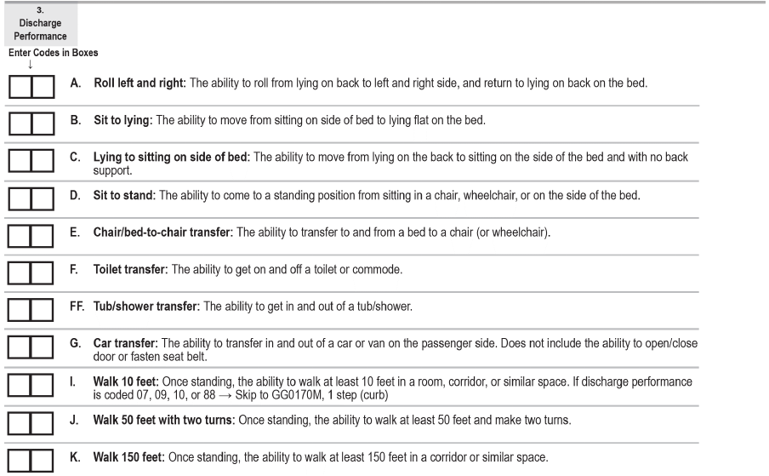
Section GG0170: Mobility Discharge
  3-day assessment period-last 3 days of the SNF PPS stay ending on A2400C OR last 3 days in facility for OBRA Discharge ending A2000
  Meant to determine resident’s “usual performance” during those 3 days
Therapy services and intellectual property provided by Functional Pathways. ©2022 All rights reserved. This information and materials were created by and is proprietary to Functional Pathways of Tennessee, LLC. Any unauthorized use, dissemination, distribution, or copying of this information and material, in whole or in part, is strictly prohibited.
Notes:
Same exact items here as in the admission assessment

Slide 41
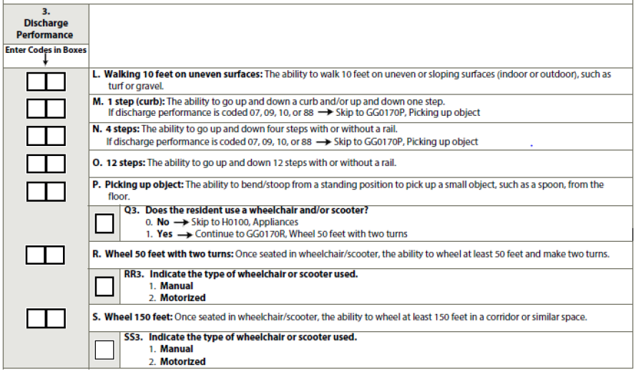
Section GG: Mobility
GG0170: Mobility Discharge-cont’d
Therapy services and intellectual property provided by Functional Pathways. ©2022 All rights reserved. This information and materials were created by and is proprietary to Functional Pathways of Tennessee, LLC. Any unauthorized use, dissemination, distribution, or copying of this information and material, in whole or in part, is strictly prohibited.

Slide 42
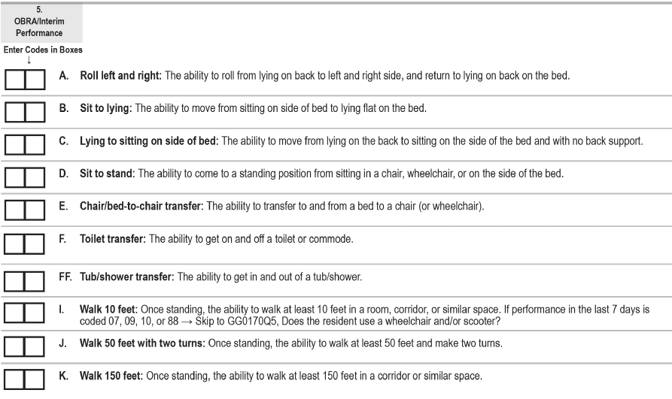
Section GG0170: Mobility OBRA/Interim
  Meant to determine resident’s “usual performance” over 3 days: ARD and 2 previous
  Uses same 6-point/Activity not attempted coding
Therapy services and intellectual property provided by Functional Pathways. ©2022 All rights reserved. This information and materials were created by and is proprietary to Functional Pathways of Tennessee, LLC. Any unauthorized use, dissemination, distribution, or copying of this information and material, in whole or in part, is strictly prohibited.
Notes:
Once again same rules as for the Self-care OBRA/Interim assessment-
3 day assessment = ARD and 2 days prior
They have combined this column-5 to cover both IPA’s and OBRA assessments- when for an IPA its intent is the same as it has been- to update the PDPM reimbursement due to a change in condition-always optional-We are updating the resident’s Functional status score, which will update the case mix groups for PT/OT and nursing, but we do not get to set new discharge GG goals with IPAs
Complete this section- column 5 when type of assessment A0310A=2-6: which is a quarterly, Annual, sig change or Sig correction and A0310B=99 (so NOT a PPS assessment)
Or for an IPA (A0310B=08)

Slide 43
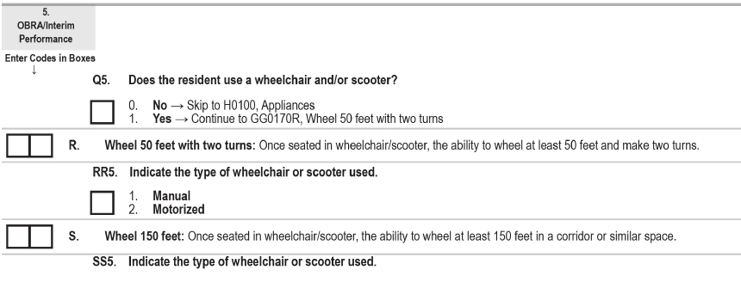
Section GG0170: Mobility OBRA/Interim (cont’d)
Therapy services and intellectual property provided by Functional Pathways. ©2022 All rights reserved. This information and materials were created by and is proprietary to Functional Pathways of Tennessee, LLC. Any unauthorized use, dissemination, distribution, or copying of this information and material, in whole or in part, is strictly prohibited.
Notes:
Notice that items L, M, N, O, P are not included-so walking 10’ on uneven surfaces, stair items, picking up an object off the floor are all not included for the interim/OBRA assessment.
Just those last few items here as they look on the MDS

Slide 44
Section GG: Documentation sources/Gathering data
Ensure caregivers understand what they are scoring-definition of what is included in each GG item
Communicate resident’s assessment/lookback window
CNA, nursing, therapy, other department documentation
GGs are meant to be collaborative amongst the Interdisciplinary team
Talk with direct care staff from each shift-have “probing conversations” with staff
Observe the resident
Determine “usual performance” for each activity over 3-day period
Ensure adequate documentation to support decision
Therapy services and intellectual property provided by Functional Pathways. ©2022 All rights reserved. This information and materials were created by and is proprietary to Functional Pathways of Tennessee, LLC. Any unauthorized use, dissemination, distribution, or copying of this information and material, in whole or in part, is strictly prohibited.
Notes:
If there is a GG or Functional ability worksheet to be employed during the 3 assessment days, implement it!

Slide 45
Section GG: Re-cap and Wrap Up
Functional status is assessed based on the need for assistance when performing self-care and mobility activities.
Used to determine resident’s “usual performance” with both self-care and mobility activities
Should be a collaborative process to determine “usual performance”
  Be sure to consider multiple sources over 3 day assessment window
Used to determine case mix groups under PDPM for PT/OT and Nursing
Used for some QMs, QRP’s and soon VBP items
  Discharge Function Score-all 3 of the above
  % residents whose need for assistance with ADL’s increased-LS QM
  % residents whose ability to walk independently worsened-LS QM
Therapy services and intellectual property provided by Functional Pathways. ©2022 All rights reserved. This information and materials were created by and is proprietary to Functional Pathways of Tennessee, LLC. Any unauthorized use, dissemination, distribution, or copying of this information and material, in whole or in part, is strictly prohibited.
Notes:
If there is a GG or Functional ability worksheet to be employed during the 3 assessment days, implement it!

Slide 46

Michael Wayman-Clinical Program Specialist mwayman@fprehab.com
Dani Beveridge –Clinical Program Specialist dbeveridge@fprehab.com
Flora Muhammad-Clinical Outcomes Nurse Specialist Fmuhammad@fprehab.com
Melissa Brandt – Clinical & Reimbursement Specialist mbrandt@fprehab.com
Jen Callahan – Clinical & Reimbursement Specialist jcallahan@fprehab.com
Karen Welsh – VP of Clinical & Reimbursement - kwelsh@fprehab.com
Therapy services and intellectual property provided by Functional Pathways. ©2022 All rights reserved. This information and materials were created by and is proprietary to Functional Pathways of Tennessee, LLC. Any unauthorized use, dissemination, distribution, or copying of this information and material, in whole or in part, is strictly prohibited.

Slide 47

Section GG0130: Self-Care Discharge
A0310F= Entry/Discharge reporting; 10=DC RNA; 11=DC RA;
A0310H= SNF Part A PPS DC assessment 0=no; 1= yes
A0310G= Type of DC 1=planned; 2=unplanned
A2000=Discharge date
A2105=Discharge status 04=Acute hospital
A2400B=Start date of Medicare stay
A2400C=End date of Medicare stay (must be greater than 2 days)
Therapy services and intellectual property provided by Functional Pathways. ©2022 All rights reserved. This information and materials were created by and is proprietary to Functional Pathways of Tennessee, LLC. Any unauthorized use, dissemination, distribution, or copying of this information and material, in whole or in part, is strictly prohibited.
Notes:
Let’s get into the messiness of this just a bit- stay with me here
A0310F= Entry/Discharge reporting; 10=DC RNA; 11=DC RA;
A0310H= SNF Part A PPS DC assessment 0=no; 1= yes
A0310G= Type of DC 1=planned; 2=unplanned
A2000=Discharge date
A2105=Discharge status 04=Acute hospital
A2400B=Start date of Medicare stay
A2400C=End date of Medicare stay

Slide 48

Section GG0170: Mobility Discharge
A0310F= Entry/Discharge reporting; 10=DC RNA; 11=DC RA;
A0310H= SNF Part A PPS DC assessment 0=no; 1= yes
A0310G= Type of DC 1=planned; 2=unplanned
A2000=Discharge date
A2105=Discharge status 04=Acute hospital
A2400B=Start date of Medicare stay
A2400C=End date of Medicare stay (must be greater than 2 days)
Therapy services and intellectual property provided by Functional Pathways. ©2022 All rights reserved. This information and materials were created by and is proprietary to Functional Pathways of Tennessee, LLC. Any unauthorized use, dissemination, distribution, or copying of this information and material, in whole or in part, is strictly prohibited.
Notes:
Same messiness as we went over for Self-Care-
A0310F= Entry/Discharge reporting; 10=DC RNA; 11=DC RA;
A0310H= SNF Part A PPS DC assessment 0=no; 1= yes
A0310G= Type of DC 1=planned; 2=unplanned
A2000=Discharge date
A2105=Discharge status 04=Acute hospital
A2400B=Start date of Medicare stay
A2400C=End date of Medicare stay

