Slide 1

Functional Pathways
MDS Boot Camp – Section H, I & J
October 2023 Update

Slide 2

MDS Sections H, I & J
  H = Bladder and Bowel
  I = Active Diagnoses
  J = Health Conditions
Therapy services and intellectual property provided by Functional Pathways. ©2022 All rights reserved. This information and materials were created by and is proprietary to Functional Pathways of Tennessee, LLC. Any unauthorized use, dissemination, distribution, or copying of this information and material, in whole or in part, is strictly prohibited.

Slide 3
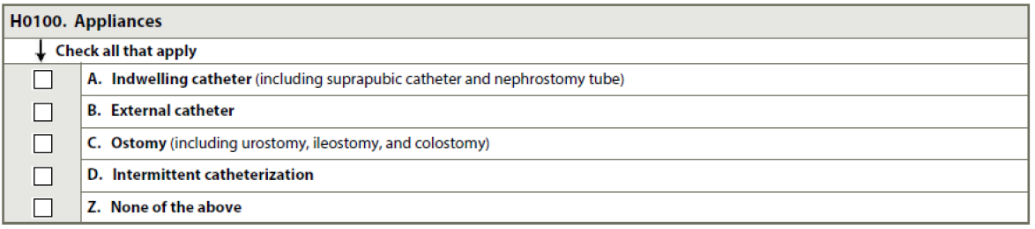
MDS Section H0100:
Appliances - 7-day lookback
Indwelling Catheter = maintained within in the bladder for continuous urine drainage
  Suprapubic Catheter = placed into the bladder through the abdomen
  Nephrostomy Tube = inserted through the skin into the kidney
  Must be valid medical justification/Diagnosis to support the use of an indwelling catheter
External Catheter = device for males for females such as a condom cath that connect to a drainage bag or pouch.
Ostomy = surgically created opening for discharge of body waste
  Excludes gastrostomy or other feeding ostomies
Intermittent Catheterization = insertion and removal of the catheter for bladder drainage
  Does not include one-time cath for obtaining a urine specimen
  Includes residents who self-cath during the lookback period
Therapy services and intellectual property provided by Functional Pathways. ©2022 All rights reserved. This information and materials were created by and is proprietary to Functional Pathways of Tennessee, LLC. Any unauthorized use, dissemination, distribution, or copying of this information and material, in whole or in part, is strictly prohibited.
Notes:
7 day lookback-in or out of facility? Or only while resident?

Slide 4
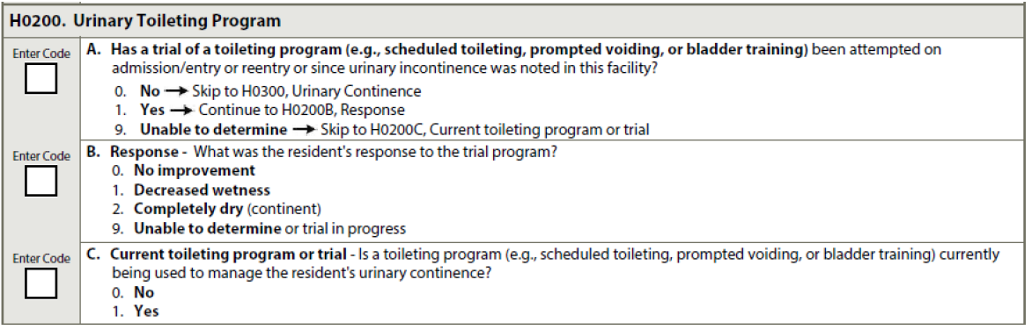
MDS Section H0200
  Urinary Toileting Program –
H0200A =
  Toileting trial includes observations of at least 3 days of toileting patterns with prompting to toilet and recording results
  Just tracking continence and “check & change” are not considered a trial – must include prompting/scheduled toileting/bladder retraining attempts
  Code 0, no if resident is continent or uses a permanent catheter or ostomy
  Note Lookback period!
H0200B = Review the response to the trial program and record level of response
    1 = resident was still incontinent but did improve
    2 = no episodes of urinary incontinence during the trial
H0200C = 7-day lookback
    0, no = toileting program/trial used less than 4 days of the 7-day lookback
    1, yes = toileting program/trial 4 or more days of the 7-day lookback
Therapy services and intellectual property provided by Functional Pathways. ©2022 All rights reserved. This information and materials were created by and is proprietary to Functional Pathways of Tennessee, LLC. Any unauthorized use, dissemination, distribution, or copying of this information and material, in whole or in part, is strictly prohibited.

Slide 5
MDS Section H0300
  Urinary Continence – 7-day Lookback
  Continent = Any void that occurs voluntarily, or as a result of prompted/assisted/scheduled toileting
  Incontinent = Involuntary loss of urine
  0 = no episodes of incontinence during the last 7 days
  1 = less than 7 incontinent episodes, includes incontinence of any amount of urine sufficient to dampen undergarments, briefs, or pads – day or night.
  2 = if resident had at least one continent void during the last 7 days
  3 = resident had zero continent voids
  9 = had to meet requirements for ENTIRE 7 days - so if a catheter was removed – code based on continence level once catheter was removed
  If patient has intermittent catheter– code based on level of continence between catheterizations
Therapy services and intellectual property provided by Functional Pathways. ©2022 All rights reserved. This information and materials were created by and is proprietary to Functional Pathways of Tennessee, LLC. Any unauthorized use, dissemination, distribution, or copying of this information and material, in whole or in part, is strictly prohibited.

Slide 6
MDS Section H0400
  Bowel Continence – 7-day Lookback
  0 = no episodes of incontinence during the last 7 days
  1 = incontinent of stool only once and includes any amount of stool, day or night
  2 = had at least one continent episode
  3 = Zero episodes of continence
  9 = if no BM in 7 days – be sure to check for impaction/constipation! Most facilities have protocols in place after 3 days.
  Stool consistency is not considered here
Therapy services and intellectual property provided by Functional Pathways. ©2022 All rights reserved. This information and materials were created by and is proprietary to Functional Pathways of Tennessee, LLC. Any unauthorized use, dissemination, distribution, or copying of this information and material, in whole or in part, is strictly prohibited.

Slide 7
MDS Section H0500
Bowel Toileting Program – 7-day lookback
  Program must meet 3 requirements:
    Resident specific toileting program based on resident’s unique bowel pattern
    Evidence that the program was communicated to the staff (and resident) verbally and written (Care Plan, flow records, etc)
    Notation of resident’s response to the program
Therapy services and intellectual property provided by Functional Pathways. ©2022 All rights reserved. This information and materials were created by and is proprietary to Functional Pathways of Tennessee, LLC. Any unauthorized use, dissemination, distribution, or copying of this information and material, in whole or in part, is strictly prohibited.

Slide 8
MDS Section H0600
Bowel Patterns – 7-day lookback
  Constipation = 2 or fewer bowel movements in the last 7 days OR if for most bowel movements stool is hard and difficult to pass – no matter what the frequency.
  Fecal Impaction = large mass of dry, hard stool in the rectum. Resident may be unable to pass the mass without assistance. Watery stool may move around the mass and leak out, causing soiling. Caused by chronic constipation – but is not synonymous with constipation.
Therapy services and intellectual property provided by Functional Pathways. ©2022 All rights reserved. This information and materials were created by and is proprietary to Functional Pathways of Tennessee, LLC. Any unauthorized use, dissemination, distribution, or copying of this information and material, in whole or in part, is strictly prohibited.

Slide 9

MDS Section I

Slide 10
MDS Section I
Purpose is to capture diseases having a direct relationship to the resident’s current status for:
      Function
      Cognition
      Mood/behavior
      Treatments
      Nursing monitoring
      Risk of Death
Goal is to get an accurate picture of the resident’s current health status
Therapy services and intellectual property provided by Functional Pathways. ©2022 All rights reserved. This information and materials were created by and is proprietary to Functional Pathways of Tennessee, LLC. Any unauthorized use, dissemination, distribution, or copying of this information and material, in whole or in part, is strictly prohibited.

Slide 11
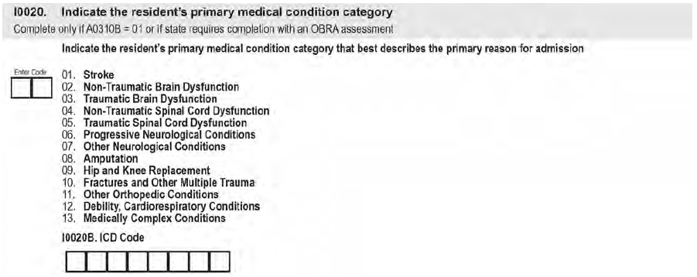
MDS Section I0020
Primary Medical Condition
Only for Medicare Part A stay – 5-day and IPA or if your state requires for OBRA assessment
Describes the primary medical category for the Medicare Stay
I0020B = the ICD 10 code of the primary reason for admit to skilled care
Therapy services and intellectual property provided by Functional Pathways. ©2022 All rights reserved. This information and materials were created by and is proprietary to Functional Pathways of Tennessee, LLC. Any unauthorized use, dissemination, distribution, or copying of this information and material, in whole or in part, is strictly prohibited.

Slide 12
MDS Section I0020 - Primary Medical Condition
01 = Stroke – includes CVA, subarachnoid hemorrhage, ischemic stroke, other cerebrovascular disease
02 = Non-Traumatic Brain Dysfunction – includes Alzheimer’s, dementia with or without behavioral disturbance, anoxic brain damage, malignant neoplasm of brain
03 = Traumatic Brain Dysfunction – includes TBI, severe concussion, cerebral laceration or contusion
04 = Non-Traumatic Spinal Cord Dysfunction – includes spondylosis with myelopathy, transverse myelitis, spinal cord lesion d/t spinal stenosis or dissection of aorta
05 = Traumatic Spinal Cord Dysfunction - includes paraplegia and quadriplegia following trauma
06 = Progressive Neurological Conditions – includes MS, Parkinson’s disease
07 = Other Neurological Conditions – includes CP, polyneuropathy, myasthenia gravis
08 = Amputation – includes acquired absence of a limb
09 = Hip and Knee Replacement - if hip replacement is due to a hip fracture – code as a fracture
10 = Fractures and Other Multiple Trauma – includes hip fracture, pelvic fracture, tibia and fibula fracture
11 = Other Orthopedic Conditions – includes unspecified disorders of joint
12 = Debility, Cardiorespiratory Conditions - includes COPD, asthma, malaise and fatigue
13 = Medically Complex Conditions – includes pneumonia, CKD, open wounds/pressure ulcer, infection, disorders of fluid, electrolyte and acid base balance
Therapy services and intellectual property provided by Functional Pathways. ©2022 All rights reserved. This information and materials were created by and is proprietary to Functional Pathways of Tennessee, LLC. Any unauthorized use, dissemination, distribution, or copying of this information and material, in whole or in part, is strictly prohibited.

Slide 13
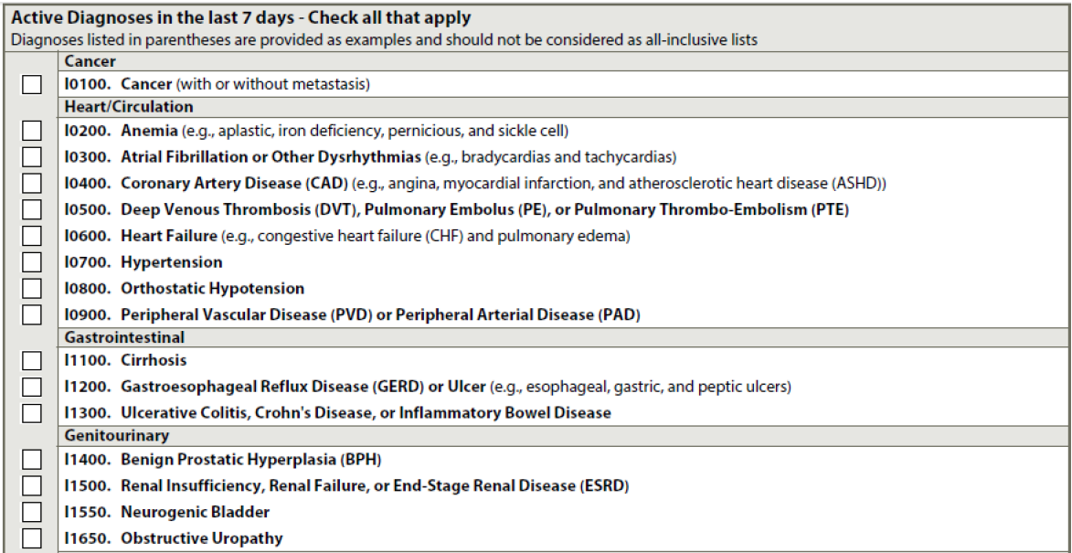
MDS Section I – Active Diagnoses in the last 7 Days
Therapy services and intellectual property provided by Functional Pathways. ©2022 All rights reserved. This information and materials were created by and is proprietary to Functional Pathways of Tennessee, LLC. Any unauthorized use, dissemination, distribution, or copying of this information and material, in whole or in part, is strictly prohibited.

Slide 14
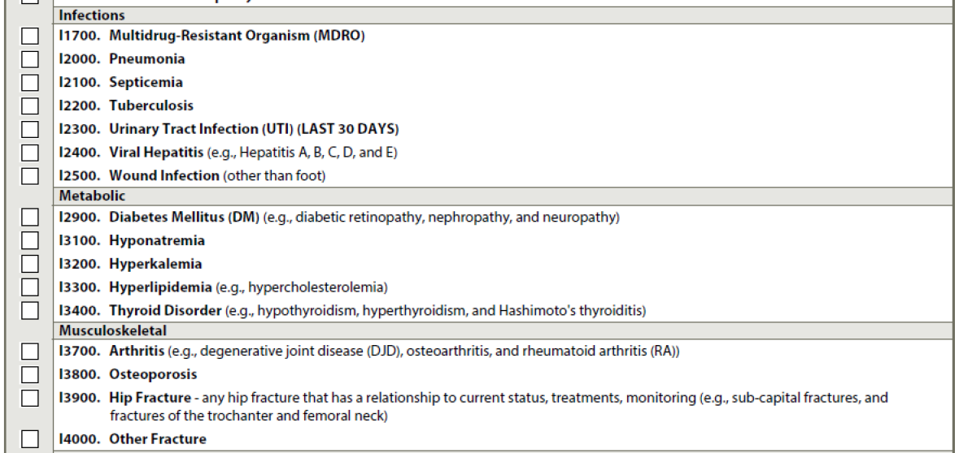
MDS Section I – Active Diagnoses in the last 7 Days
Therapy services and intellectual property provided by Functional Pathways. ©2022 All rights reserved. This information and materials were created by and is proprietary to Functional Pathways of Tennessee, LLC. Any unauthorized use, dissemination, distribution, or copying of this information and material, in whole or in part, is strictly prohibited.

Slide 15
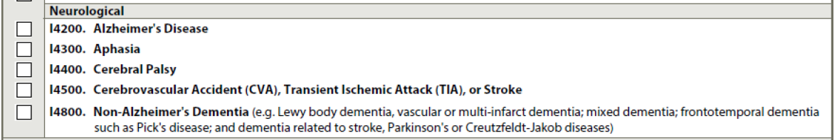
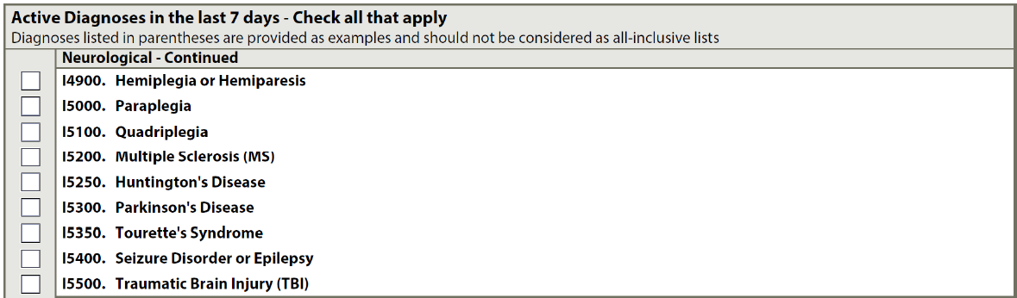
MDS Section I – Active Diagnoses in the last 7 Days
Therapy services and intellectual property provided by Functional Pathways. ©2022 All rights reserved. This information and materials were created by and is proprietary to Functional Pathways of Tennessee, LLC. Any unauthorized use, dissemination, distribution, or copying of this information and material, in whole or in part, is strictly prohibited.

Slide 16
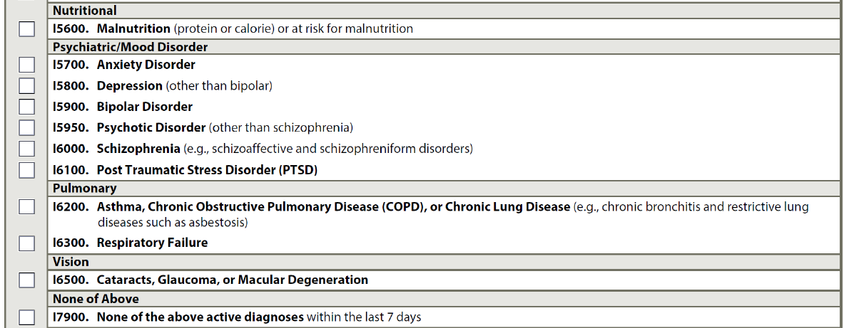
MDS Section I – Active Diagnoses in the last 7 Days
Therapy services and intellectual property provided by Functional Pathways. ©2022 All rights reserved. This information and materials were created by and is proprietary to Functional Pathways of Tennessee, LLC. Any unauthorized use, dissemination, distribution, or copying of this information and material, in whole or in part, is strictly prohibited.

Slide 17
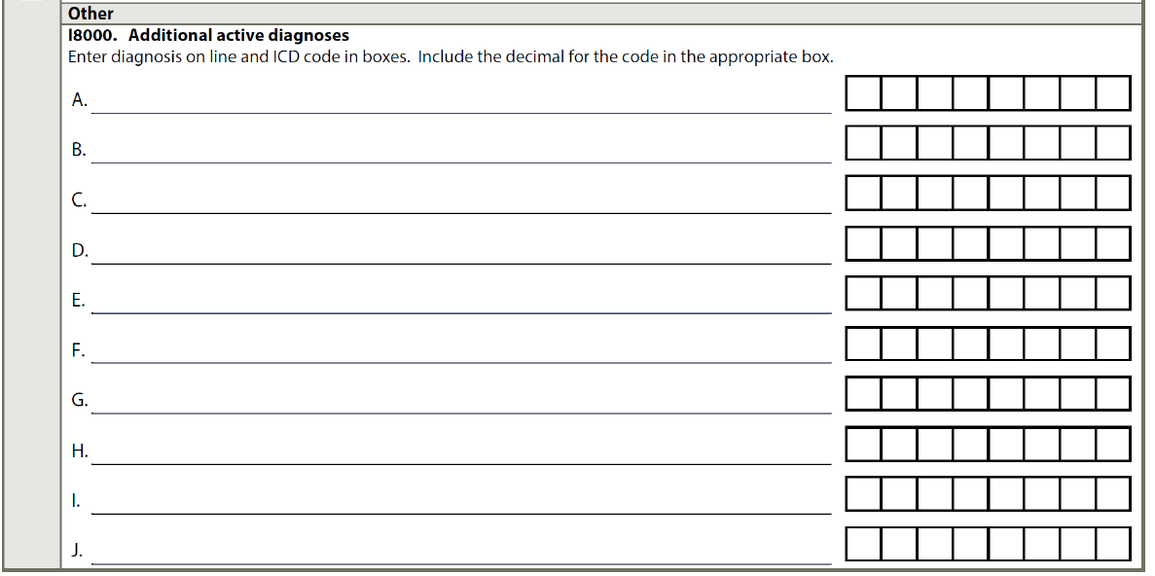
MDS Section I – Active Diagnoses in the last 7 Days
Therapy services and intellectual property provided by Functional Pathways. ©2022 All rights reserved. This information and materials were created by and is proprietary to Functional Pathways of Tennessee, LLC. Any unauthorized use, dissemination, distribution, or copying of this information and material, in whole or in part, is strictly prohibited.

Slide 18
MDS Section I – Active Diagnoses
Two Lookback periods for this section when determining active diagnoses:
  Step 1 - Diagnosis identification is a 60-day lookback
    Must be a physician-documented Dx in the medical record (NP, PA or CNS per state licensure laws)
  Step 2 – Diagnosis status – Active or Inactive in the last 7 days (exception is I2300 UTI)
    Active Diagnosis = have a direct relationship to the resident’s current functional, cognitive, mood or behavior status, medical treatments, nursing monitoring or risk of death during the 7-day lookback.
    Do not include conditions that are resolved, do not affect current status or do not drive the plan of care.
  Check all active diseases that apply under each major disease category.
  If a disease or condition is not specifically listed – enter the Dx and ICD10 in I8000
  Z codes (aftercare) can be used – but should also have another Dx for the related primary medical condition checked or entered at I8000
  https://www.cms.gov/Medicare/Coding/ICD10/index.html
  I2300 – UTI - lookback is last 30 days and must be:
    Determined by using evidenced based criteria (McGreer, Loeb, etc) AND
    Physician documented UTI diagnosis
  I5100 – Quadriplegia – paralysis of all four limbs cause by spinal cord injury – not the result of another condition i.e. CP, stroke, contracture, etc.
Therapy services and intellectual property provided by Functional Pathways. ©2022 All rights reserved. This information and materials were created by and is proprietary to Functional Pathways of Tennessee, LLC. Any unauthorized use, dissemination, distribution, or copying of this information and material, in whole or in part, is strictly prohibited.

Slide 19

MDS Section J– Health Conditions
Therapy services and intellectual property provided by Functional Pathways. ©2022 All rights reserved. This information and materials were created by and is proprietary to Functional Pathways of Tennessee, LLC. Any unauthorized use, dissemination, distribution, or copying of this information and material, in whole or in part, is strictly prohibited.

Slide 20
MDS Section J0100
  Pain Management - 5-day Lookback
  Include all medications used for pain management by any route – oral, transcutaneous, intramuscular, rectal, IV, intraspinal. Does not include meds that primarily target treatment of the underlying condition i.e. chemotherapy or steroids.
  Non-medication intervention = includes biofeedback , PT, nerve block, heat/cold, massage, E-stim, acupuncture/pressure, chiropractic. Herbal/alternative medicine products are not included here.
Therapy services and intellectual property provided by Functional Pathways. ©2022 All rights reserved. This information and materials were created by and is proprietary to Functional Pathways of Tennessee, LLC. Any unauthorized use, dissemination, distribution, or copying of this information and material, in whole or in part, is strictly prohibited.

Slide 21
MDS Section J0200
  Should Pain Assessment Interview Be Conducted
  Attempt the interview with ALL residents during the lookback period.
  It is not contingent on B0700 Makes Self Understood
  If the interview should have been conducted, but wasn’t done – Code J0200 1, Yes and enter a “-” in J0300-J0600.
  Do not complete the Staff Assessment for Pain if the resident interview should have been done, but wasn’t
  If resident needs an interpreter, but one is not available – code J0200 0, No and proceed to Staff Assessment
Therapy services and intellectual property provided by Functional Pathways. ©2022 All rights reserved. This information and materials were created by and is proprietary to Functional Pathways of Tennessee, LLC. Any unauthorized use, dissemination, distribution, or copying of this information and material, in whole or in part, is strictly prohibited.

Slide 22
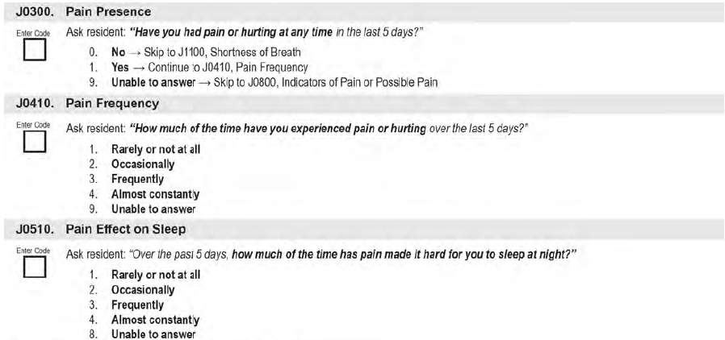
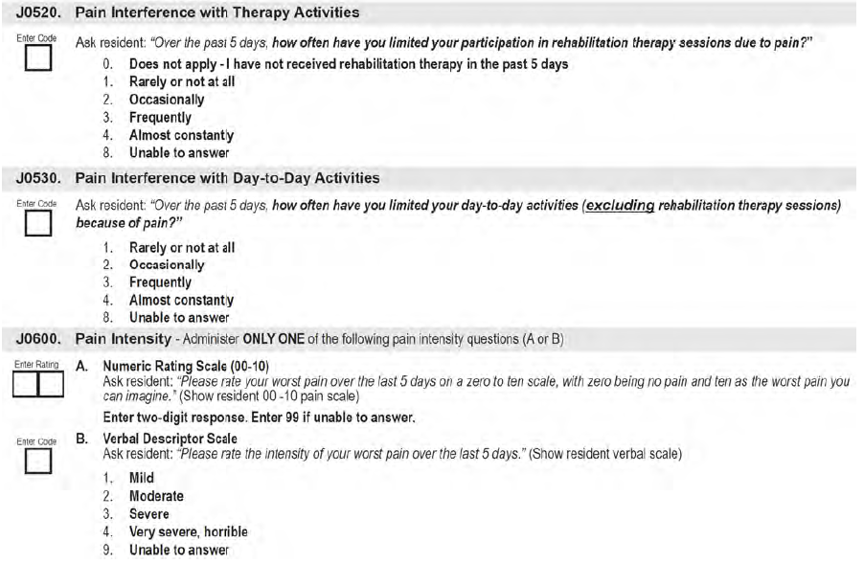
MDS Section J0300-J0600 - Pain Presence
Therapy services and intellectual property provided by Functional Pathways. ©2022 All rights reserved. This information and materials were created by and is proprietary to Functional Pathways of Tennessee, LLC. Any unauthorized use, dissemination, distribution, or copying of this information and material, in whole or in part, is strictly prohibited.

Slide 23
MDS Section J0300-J0600 – Pain Interview
  Interview should be conducted as close to the ARD as possible
  Use other terms for pain if resident seems unsure or hesitant – i.e. hurt, ache, burn
  If resident chooses not to answer – code 9 and move to next item
  If unable to select between responses – select the more frequent of the two
  Ensure resident can hear and see you clearly
  Section J0320 – Pain Interference with Therapy Activities – Does not include restorative nursing programs
Therapy services and intellectual property provided by Functional Pathways. ©2022 All rights reserved. This information and materials were created by and is proprietary to Functional Pathways of Tennessee, LLC. Any unauthorized use, dissemination, distribution, or copying of this information and material, in whole or in part, is strictly prohibited.

Slide 24
MDS Section J0700 – J0800
  Should Staff Assessment for Pain be Conducted (5-day lookback)
  Only complete Staff Assessment if resident Pain Interview was not completed
Therapy services and intellectual property provided by Functional Pathways. ©2022 All rights reserved. This information and materials were created by and is proprietary to Functional Pathways of Tennessee, LLC. Any unauthorized use, dissemination, distribution, or copying of this information and material, in whole or in part, is strictly prohibited.

Slide 25
MDS Section J0850
  Frequency of Indicator of Pain or Possible Pain (5-day lookback)
  Based on staff observation and documentation in the medical record
Therapy services and intellectual property provided by Functional Pathways. ©2022 All rights reserved. This information and materials were created by and is proprietary to Functional Pathways of Tennessee, LLC. Any unauthorized use, dissemination, distribution, or copying of this information and material, in whole or in part, is strictly prohibited.

Slide 26
MDS Section J1100
  Shortness of Breath (dyspnea) – 7-day lookback
  Interview the resident/family, query the medical record, record staff observations for signs of shortness of breath: increased respiratory rate, pursed lip breathing, audible respirations, gasping for air at rest, interrupted speech patterns, use of shoulder/accessory muscles to breathe.
  Shortness of breath when lying flat maps to Nursing Category Special Care High
Therapy services and intellectual property provided by Functional Pathways. ©2022 All rights reserved. This information and materials were created by and is proprietary to Functional Pathways of Tennessee, LLC. Any unauthorized use, dissemination, distribution, or copying of this information and material, in whole or in part, is strictly prohibited.

Slide 27
MDS Section J1300 – J1400
  Current Tobacco Use – 7-day lookback
  Includes any form of tobacco
  Prognosis
  If resident is terminally ill or on hospice services, code 1, Yes
Therapy services and intellectual property provided by Functional Pathways. ©2022 All rights reserved. This information and materials were created by and is proprietary to Functional Pathways of Tennessee, LLC. Any unauthorized use, dissemination, distribution, or copying of this information and material, in whole or in part, is strictly prohibited.

Slide 28
MDS Section J1550
  Problem Conditions - 7-day lookback
  Fever = temp 2.4 degrees F higher than baseline. If baseline has not been established – temp of 100.4 F on admission would be considered a fever. To establish a baseline – AMA recommends taking the temp for the first 3 days after admission and average them together to get the patient's baseline.
  Dehydrated = 2 or more of the following:
    Takes in less than 1,500 ml of fluids daily
    Has one or more indicators such as dry mucous membranes, poor skin turgor, thirst, sunken eyes, dark urine, abnormal labs, increased confusion.
    Fluid loss exceeds amount of fluids taken in
  Internal bleeding = may be frank or occult. Does not include nose bleeds that are easily stopped, menses, or urinalysis that shows small amount of red blood cells
Therapy services and intellectual property provided by Functional Pathways. ©2022 All rights reserved. This information and materials were created by and is proprietary to Functional Pathways of Tennessee, LLC. Any unauthorized use, dissemination, distribution, or copying of this information and material, in whole or in part, is strictly prohibited.
Notes:
Any guidance on establishing baseline temp?

Slide 29
MDS Section J1700
  Fall History on Admission/Entry or Reentry
  Fall = unintentional change in position coming to rest on the ground, floor or onto the next lower surface (bed, chair, beside mat)
  Falls are not a result of an overwhelming external force (being pushed or pulled)
  An intercepted fall is still a fall
  Based on resident’s entry date at A1600
  Include only fractures that occurred as a direct result of a fall
Therapy services and intellectual property provided by Functional Pathways. ©2022 All rights reserved. This information and materials were created by and is proprietary to Functional Pathways of Tennessee, LLC. Any unauthorized use, dissemination, distribution, or copying of this information and material, in whole or in part, is strictly prohibited.

Slide 30
MDS Section J1800
  Any Falls Since Admit/Entry or Reentry or Prior Assessment (OBRA or Scheduled PPS)
  If this is the first assessment (A0310E = 1) – review records from admit date to ARD
  If not the first assessment – review period is from the day after the ARD of the last MDS assessment to the ARD of the current assessment
  Includes falls that happened outside of the facility
Therapy services and intellectual property provided by Functional Pathways. ©2022 All rights reserved. This information and materials were created by and is proprietary to Functional Pathways of Tennessee, LLC. Any unauthorized use, dissemination, distribution, or copying of this information and material, in whole or in part, is strictly prohibited.

Slide 31
MDS Section J1900
  Number of Falls Since Admit/Entry or Reentry or Prior Assessment
  If this is the first assessment (A0310E = 1) – review records from admit date to ARD
  If not the first assessment – review period is from the day after the ARD of the last MDS assessment to the ARD of the current assessment
  Includes falls that happened outside of the facility
  If level of injury related to a fall is identified after the ARD and is different from what was originally coded – must modify the assessment
Therapy services and intellectual property provided by Functional Pathways. ©2022 All rights reserved. This information and materials were created by and is proprietary to Functional Pathways of Tennessee, LLC. Any unauthorized use, dissemination, distribution, or copying of this information and material, in whole or in part, is strictly prohibited.

Slide 32
MDS Section J2000
  Prior Surgery
  Only coded for Medicare Part A stays (helps determine PDPM PT/OT CMG)
  Major Surgery =
    Resident was an inpatient in an acute care hospital for at least one day in the 100 days prior to admission to the SNF AND
    the surgery carried some degree of risk to the resident’s life or the potential for severe disability
    Examples of major surgery – bowel resection, cholecystectomy, open heart surgery, hip replacement or repair, craniotomy, transplant or organ removal
Therapy services and intellectual property provided by Functional Pathways. ©2022 All rights reserved. This information and materials were created by and is proprietary to Functional Pathways of Tennessee, LLC. Any unauthorized use, dissemination, distribution, or copying of this information and material, in whole or in part, is strictly prohibited.

Slide 33
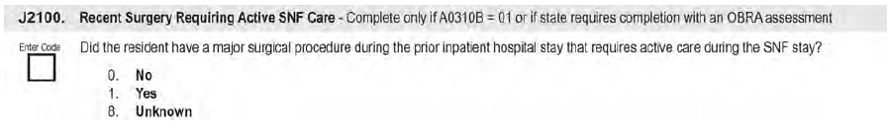
MDS Section J2100
  Recent Surgery Requiring Active SNF Care
  Complete only for Medicare Part A stay or if State requires for an OBRA assessment
  Code 1, Yes if the major surgery occurred during the inpatient stay that immediately preceded the Part A admission
Therapy services and intellectual property provided by Functional Pathways. ©2022 All rights reserved. This information and materials were created by and is proprietary to Functional Pathways of Tennessee, LLC. Any unauthorized use, dissemination, distribution, or copying of this information and material, in whole or in part, is strictly prohibited.

Slide 34
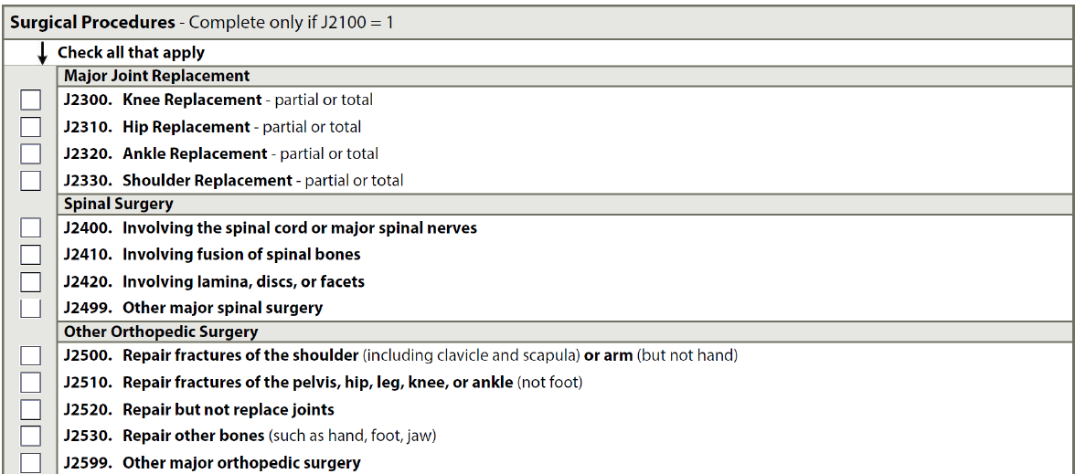
MDS Section J2300 – J5000
Therapy services and intellectual property provided by Functional Pathways. ©2022 All rights reserved. This information and materials were created by and is proprietary to Functional Pathways of Tennessee, LLC. Any unauthorized use, dissemination, distribution, or copying of this information and material, in whole or in part, is strictly prohibited.

Slide 35
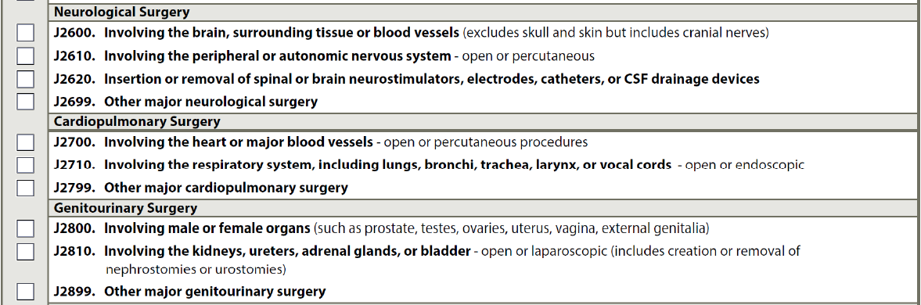
MDS Section J2300 – J5000
Therapy services and intellectual property provided by Functional Pathways. ©2022 All rights reserved. This information and materials were created by and is proprietary to Functional Pathways of Tennessee, LLC. Any unauthorized use, dissemination, distribution, or copying of this information and material, in whole or in part, is strictly prohibited.

Slide 36
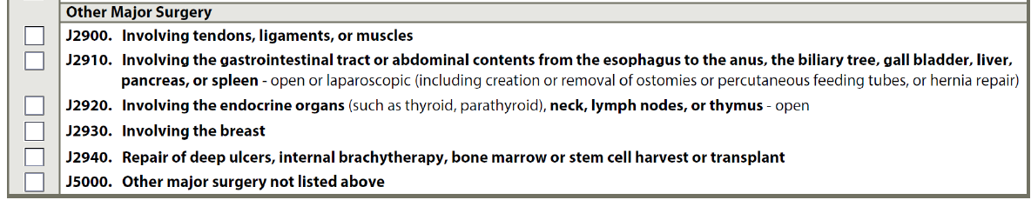
MDS Section J2300 – J5000
  Surgeries must be documented by the physician in the last 30 days and must have occurred during the inpatient stay immediately prior to the Part A admission
  Determine if the surgery requires active care during the SNF stay. It must have a direct relationship to the primary SNF diagnosis in I0020B.
Therapy services and intellectual property provided by Functional Pathways. ©2022 All rights reserved. This information and materials were created by and is proprietary to Functional Pathways of Tennessee, LLC. Any unauthorized use, dissemination, distribution, or copying of this information and material, in whole or in part, is strictly prohibited.

Slide 37

Section H-J Reminders!
  Be sure to watch lookback periods! Multiple different ones in these sections
  Ensure timely and accurate MD/NP/PA documentation of active diagnoses
  Review all medications for accurate diagnoses and code appropriately in section I – ensure the MD/NP/NA are not using just a symptom – but what causes a symptom that is being treated
  Refer to the RAI manual often for Diagnoses, fall, and surgery examples and coding tips
Therapy services and intellectual property provided by Functional Pathways. ©2022 All rights reserved. This information and materials were created by and is proprietary to Functional Pathways of Tennessee, LLC. Any unauthorized use, dissemination, distribution, or copying of this information and material, in whole or in part, is strictly prohibited.

Slide 38
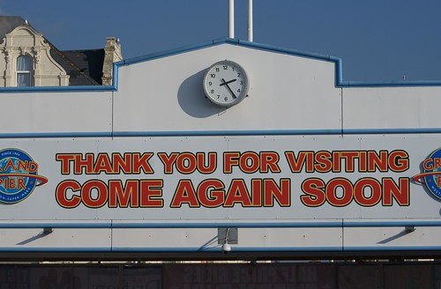
For questions - Contact the FP Clinical Team:
clinical@fprehab.com
Therapy services and intellectual property provided by Functional Pathways. ©2022 All rights reserved. This information and materials were created by and is proprietary to Functional Pathways of Tennessee, LLC. Any unauthorized use, dissemination, distribution, or copying of this information and material, in whole or in part, is strictly prohibited.

