Slide 1

Functional Pathway
October Changes: Here We Go Again!
Notes:
Thank you all for joining us today. I am Melissa and I am joined today by Michael Wayman. We are both Clinical Outcomes and Reimbursement Specialists with Functional Pathways. Let’s talk about some housekeeping items before we start today. . . . We have you all muted, but the chat feature is available, and I have fabulous clinical team members standing by to answer your questions or we will catch them at the end. Also A lot of you may want to reference this information later so we will provide you with our client portal information at the end of this presentation, there you can print out the PPT or rewatch or share the presentation. We also have a variety of other resources out there for you and your teams, but more to come on that. We figured out on Tuesday that this will not take the entire hour so we will be giving you some of your life back today . . . On a Thursday!
October Changes: Here we go again!. . . We are going to discuss a variety of topics today to include PDPM case mix, ICD 10 codes, key changes to the MDS by section, a little on Medicaid and its conversion to PDPM, QRP’s, VBP’s, Validation processes and more as we try to keep it all straight.
So let’s get these updates and changes figured out.
But first we want to see how much you can tell us . . .so Michael what is our first poll for these fine folks today?

Slide 2

Therapy services and intellectual property provided by Functional Pathways. ©2025 All rights reserved. This information and materials were created by and is proprietary to Functional Pathways of Tennessee, LLC. Any unauthorized use, dissemination, distribution, or copying of this information and material, in whole or in part, is strictly prohibited.
Notes:
Are you a rock start at MDS Oct changes?
Every Oct we can expect these changes. . . .

Slide 3

Objectives
Understand the key changes in the FY 2026 MDS (Minimum Data Set) updates and their implementation timeline
Identify new or revised assessment items and coding instructions that impact clinical practice, care planning, and reimbursement
Explain how the updates align with CMS quality initiatives, value-based purchasing, and quality measures
Recognize the implications of the updates for interdisciplinary team communication, compliance, and survey readiness
Access available resources, training tools, and CMS guidance to support successful adoption of the FY 2026 changes
Therapy services and intellectual property provided by Functional Pathways. ©2025 All rights reserved. This information and materials were created by and is proprietary to Functional Pathways of Tennessee, LLC. Any unauthorized use, dissemination, distribution, or copying of this information and material, in whole or in part, is strictly prohibited.
Notes:
here are the objectives for our discussion today, by the end of this presentation we are going to
Alright Michael take it away . . . .

Slide 4

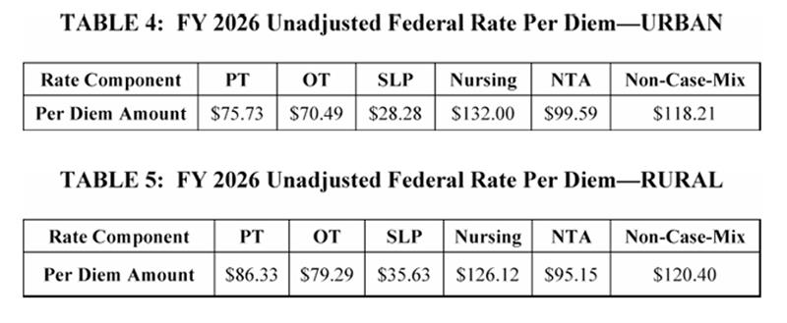
Payment Rate Update
3.2% increase in SNF PPS rates
3.3% market basket update
+ 0.6% forecast error adjustment
- 0.7% productivity adjustment
$1.16 billion increase in payments for FY 2026
Therapy services and intellectual property provided by Functional Pathways. ©2025 All rights reserved. This information and materials were created by and is proprietary to Functional Pathways of Tennessee, LLC. Any unauthorized use, dissemination, distribution, or copying of this information and material, in whole or in part, is strictly prohibited.
Notes:
These tables reflect amounts prior the adjustments of case mix
This 1.16 billion increase will be distributed between 15000 + SNF's today
2025 the increase was 4.2% . . .

Slide 5
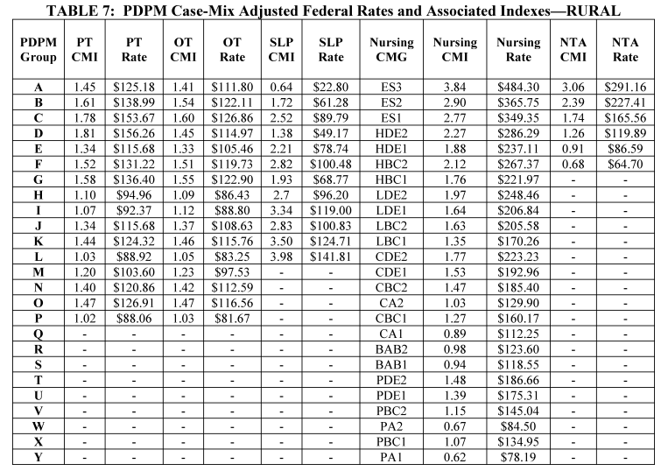
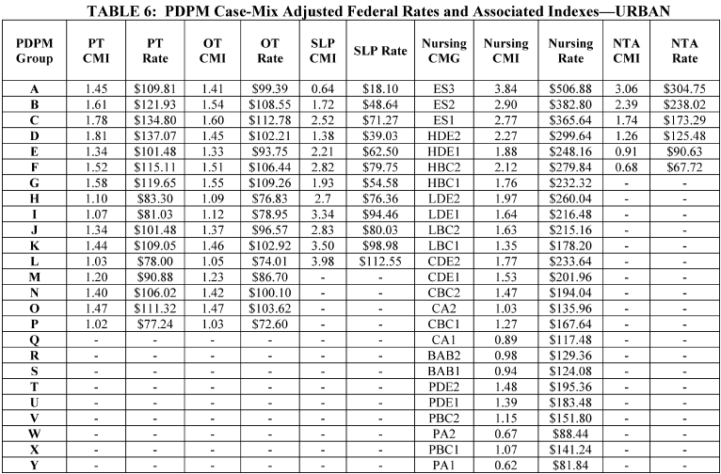
PDPM Case-Mix
Urban
Rural
Therapy services and intellectual property provided by Functional Pathways. ©2025 All rights reserved. This information and materials were created by and is proprietary to Functional Pathways of Tennessee, LLC. Any unauthorized use, dissemination, distribution, or copying of this information and material, in whole or in part, is strictly prohibited.
Notes:
Case Mix Adjusted Federal Rates and Associated Indexes
These tables do not reflect adjustments which may be made to the SNF PPS rates because of the SNF VBP Program or other adjustments such as the variable per diem adjustment

Slide 6
Geographical Wage Index (WI)
Urban vs. Rural
Unique WI for each county or state
WI is variable used to take the Total Daily Per Diem Rate and adjust it up or down
CMS Finalized Budget Neutrality factor for FY 2026 – 1.0018
You SNF’s Total Daily Rate = (Labor Portion x Your SNF’s Wage Index) + Non-Labor Portion
https://www.cms.gov/medicare/payment/prospective-payment-systems/skilled-nursing-facility-snf/wage-index
Therapy services and intellectual property provided by Functional Pathways. ©2025 All rights reserved. This information and materials were created by and is proprietary to Functional Pathways of Tennessee, LLC. Any unauthorized use, dissemination, distribution, or copying of this information and material, in whole or in part, is strictly prohibited.
Notes:
The wage data is derived from the Office of Management and Budget which comes from census data.
WI: this levels the labor field, it is more expensive to hire staffing CA than in SC . . . 0.7 in SC and 1.1 in CA
This impacts your daily rate

Slide 7
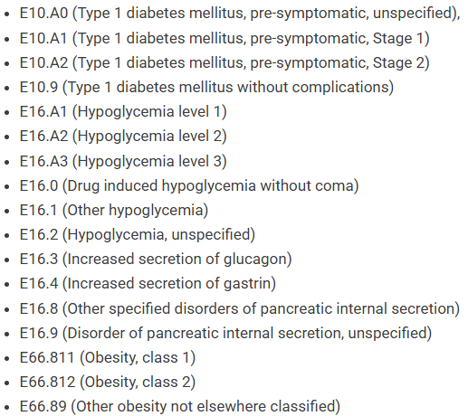
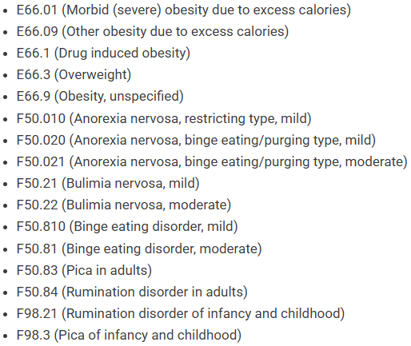

ICD 10 Codes with Mapping Changes
34 Med Management →RTP
Acute Neuro→Med Management
https://www.cms.gov/files/zip/fy-2026-pdpm-icd-10-mapping-nprm.zip
Therapy services and intellectual property provided by Functional Pathways. ©2025 All rights reserved. This information and materials were created by and is proprietary to Functional Pathways of Tennessee, LLC. Any unauthorized use, dissemination, distribution, or copying of this information and material, in whole or in part, is strictly prohibited.
Notes:
CMS notes that these 34 codes typically occur on an outpatient basis and do not require and inpatient stay

Slide 8

Therapy services and intellectual property provided by Functional Pathways. ©2025 All rights reserved. This information and materials were created by and is proprietary to Functional Pathways of Tennessee, LLC. Any unauthorized use, dissemination, distribution, or copying of this information and material, in whole or in part, is strictly prohibited.

Slide 9

2026: MDS Changes
Therapy services and intellectual property provided by Functional Pathways. ©2025 All rights reserved. This information and materials were created by and is proprietary to Functional Pathways of Tennessee, LLC. Any unauthorized use, dissemination, distribution, or copying of this information and material, in whole or in part, is strictly prohibited.

Slide 10
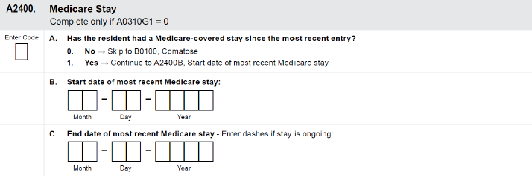
Section A: Identification Information
A0800 Gender – removed and replaced with A0810 Sex on all assessments
A1255 (was A1250) Transportation
A2000 Discharge Date removed from the End of PPS MDS
A2400 Medicare Stay No/Yes change in skip pattern for End of PPS MDS
Therapy services and intellectual property provided by Functional Pathways. ©2025 All rights reserved. This information and materials were created by and is proprietary to Functional Pathways of Tennessee, LLC. Any unauthorized use, dissemination, distribution, or copying of this information and material, in whole or in part, is strictly prohibited.
Notes:
A1250 – was supposed to go to section R (a new section) that MDS has scrapped . . . So now it has a new number: A1255

Slide 11

Section B: Hearing, Speech and Vision
B0100 Comatose change in skip pattern based on answer for End of PPS MDS
Therapy services and intellectual property provided by Functional Pathways. ©2025 All rights reserved. This information and materials were created by and is proprietary to Functional Pathways of Tennessee, LLC. Any unauthorized use, dissemination, distribution, or copying of this information and material, in whole or in part, is strictly prohibited.
Notes:
The Old Skip pattern: If a resident was comotose, the assessor would skip a series of questions in Section B and G
New Skip Pattern: If B0100 Comatose is coded as yes (1), the skip pattern now directs the assessor to GG0110: Prior Functioning Everyday Activities, bypassing items B0200-F0800

Slide 12

Section D: Mood
PHQ 2 to 9
If the resident cannot provide a frequency, following a yes response to a symptom in column 1, enter a dash in column 2.
CMS expects a dash response to be rare.
If symptom frequency in items D0150A2 through D0150I2 is blank or dashed for 3 or more items, the interview is deemed NOT complete.
Therapy services and intellectual property provided by Functional Pathways. ©2025 All rights reserved. This information and materials were created by and is proprietary to Functional Pathways of Tennessee, LLC. Any unauthorized use, dissemination, distribution, or copying of this information and material, in whole or in part, is strictly prohibited.

Slide 13

Section I: Active Diagnosis
I7900 Active Diagnosis “None of the Above” added to Quarterly, OBRA DC, 5 Day
Therapy services and intellectual property provided by Functional Pathways. ©2025 All rights reserved. This information and materials were created by and is proprietary to Functional Pathways of Tennessee, LLC. Any unauthorized use, dissemination, distribution, or copying of this information and material, in whole or in part, is strictly prohibited.

Slide 14
Section O: Special Treatments, Procedures and Programs
What’s Leaving
O0400 “Therapies”-will be removed from all MDS’s
Start Date, End Date, Type/Mode of Therapy, Total Days & Total Minutes
Therapy, Respiratory, Psychological and Recreational
Exception O0420D2 Respiratory-Distinct Calendar Days will remain due to information needed for HIPPS codes
O0420 Distinct Calendar Days of Therapy – will be removed from all non-Medicare Part A resident assessments
What’s Staying:
O0425 Part A Therapies
O0430 Distinct Calendar Days of Part A Therapy
Respiratory Therapy days – needed for HIPPS code calculations
Therapy services and intellectual property provided by Functional Pathways. ©2025 All rights reserved. This information and materials were created by and is proprietary to Functional Pathways of Tennessee, LLC. Any unauthorized use, dissemination, distribution, or copying of this information and material, in whole or in part, is strictly prohibited.

Slide 15
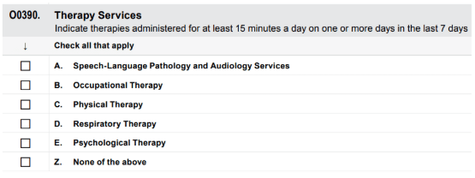
Section O continued:
New:
O0390 will be added to OBRA Admission, Quarterly, Annual Significant Change and the PPS 5-Day
Therapy services have been provided for at least 15 minutes on any one day in 7-day look-back window
Tells us therapy was provided
Appears vague . . . Will this stay? Only time will tell
Removal of these Section O items will save the burden on MDS by 6.6 minutes.
Recreational Therapy has been completely removed from the MDS
Therapy services and intellectual property provided by Functional Pathways. ©2025 All rights reserved. This information and materials were created by and is proprietary to Functional Pathways of Tennessee, LLC. Any unauthorized use, dissemination, distribution, or copying of this information and material, in whole or in part, is strictly prohibited.

Slide 16
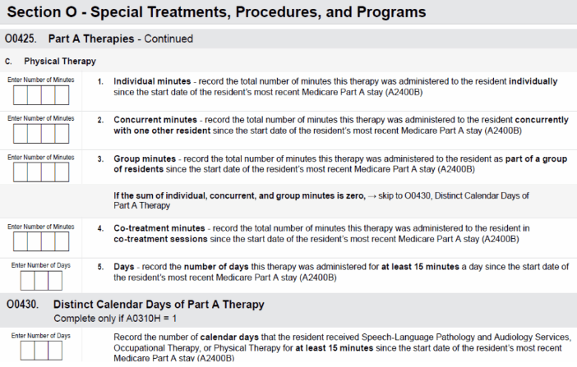
How do we monitor Therapy?
Medicare Part A Residents monitor will occur at the end of the Medicare Stay
O0425 Total therapy Days and Minutes of the entire Part A stay are captured here
O0430 Distinct Calendar days of Part Therapy – this will be used to track the % of group and concurrent to monitor over the 25% threshold
All residents, regardless of payor will use a new therapy question added 10/1/25
O0400 has been retired
For ALL OTHER residents, the details about therapy will not be on the MDS at all . . .
Therapy services and intellectual property provided by Functional Pathways. ©2025 All rights reserved. This information and materials were created by and is proprietary to Functional Pathways of Tennessee, LLC. Any unauthorized use, dissemination, distribution, or copying of this information and material, in whole or in part, is strictly prohibited.

Slide 17

Medicaid Changes over to PDPM
Varies have existed from state to state over the past few years
RUG
PDPM
Combination
The changes with section O will force states to transition to PDPM
States can use the PDPM model as a whole or choose components
PT/OT, Speech, Nursing and NTA
Nursing Only
Nursing and NTA
What does this mean for therapy?
Federal regulations in place that require SNF’s to ensure residents attain and maintain their highest level of function
Therapy departments have to monitor and assess
Purpose and importance of therapy for the long-term care residents will not change
Therapy services and intellectual property provided by Functional Pathways. ©2025 All rights reserved. This information and materials were created by and is proprietary to Functional Pathways of Tennessee, LLC. Any unauthorized use, dissemination, distribution, or copying of this information and material, in whole or in part, is strictly prohibited.

Slide 18

Section X: Correction Requests
X0310 Gender – changed to Sex
Therapy services and intellectual property provided by Functional Pathways. ©2025 All rights reserved. This information and materials were created by and is proprietary to Functional Pathways of Tennessee, LLC. Any unauthorized use, dissemination, distribution, or copying of this information and material, in whole or in part, is strictly prohibited.

Slide 19

Therapy services and intellectual property provided by Functional Pathways. ©2025 All rights reserved. This information and materials were created by and is proprietary to Functional Pathways of Tennessee, LLC. Any unauthorized use, dissemination, distribution, or copying of this information and material, in whole or in part, is strictly prohibited.
Notes:
So now it is my turn to talk about some QRP, VBP items and more. Most of you might feel like you want to sit down and say "I can't do it!" But we have to remember that Medicare is looking at QM's, QRP's and VBP's for the benefit of the residents we serve. So how can we all get to the success step? Hopefully what I share in the next few minutes will clear up some questions that you have.

Slide 20

SNF Quality Reporting Program
4 SDOH removal starting on or after October 2025 and will affect FY 2027 QRP
Living situation
Two food items
Within the Past 12 months, you worried that your food would run out before you got to buy more
Withing the Past 12 months, the food you bought just didn’t last and you didn’t have money to get more
Utilities
Estimated to reduce burden by ~31,791 hours annually = 2.08 hours/SNF
Transportation
Renumbered to A1255 instead of A1250
Therapy services and intellectual property provided by Functional Pathways. ©2025 All rights reserved. This information and materials were created by and is proprietary to Functional Pathways of Tennessee, LLC. Any unauthorized use, dissemination, distribution, or copying of this information and material, in whole or in part, is strictly prohibited.
Notes:
As you can see Living situation, two food items, and utilities will be removed from the MDS they were not using these for risk adjustments or performance measures, so CMS re-evaluated the purpose of these items. Section R of the MDS which was proposed was removed and this resulted in renumbering transportation as Michael mentioned before to keep it in the data collection so it will be A1255 now. The reason for the removal of the items you see on the screen is that CMS doesn't feel that these are within the scope of care a SNF and its staff to provide. CMS felt that this placed a burden on sites having to capture this data and estimate that it will save over 31 thousand hours annually.
CMS has a vision for a low burden interoperable electronic system for these elements to be collected in the future. I am not sure when they have provided us with a low burden system, but I will keep my fingers crossed.

Slide 21
SNF Quality Reporting Program
Amendments to the Reconsideration Policy and Process
This would allow SNFs to request an extension to file a request for reconsideration
A reconsideration of a non-compliance determination if they had an extraordinary circumstance
CMS will notify the community via email with its final decision
CMS’ modification to its reconsideration policy is to provide timely request for reconsideration and will reverse any initial finding ONLY if CMS determines the SNF is in full compliance with QRP for that applicable year.
SNFQRPReconsiderations@cms.hhs.gov
Therapy services and intellectual property provided by Functional Pathways. ©2025 All rights reserved. This information and materials were created by and is proprietary to Functional Pathways of Tennessee, LLC. Any unauthorized use, dissemination, distribution, or copying of this information and material, in whole or in part, is strictly prohibited.
Notes:
Non-compliance determination is made by CMS or a state survey agency when a provider fails to meet federal health, safety, quality, or other requirements. You have “no later than 30 calendar days from the date of the written notification of noncompliance” to contact CMS. I am going to bring you attention to the response time for each of the reconsiderations and validations that I talk about today because they are all different. . . . Let’s be honest It would be too simple to make the response time the same for us.
Medicare is changing the terminology from “extenuating circumstances” to “extraordinary circumstances.” What are extraordinary circumstances you might ask: well, they are natural disasters (hurricanes, floods or earthquakes, widespread events like public health emergencies or pandemics-which unfortunately we are all now familiar with, infrastructure failures like loss of electricity, internet or communications for an extended period of time, temporary closure of a facility or any event that makes reporting required data impossible.
You would fill out the CMS Quality Program Extraordinary Circumstances Exceptions Request Form. Let’s all say that 3 times . . .
They estimate that this information will take SNFs approximately 15 minutes to complete.

Slide 22
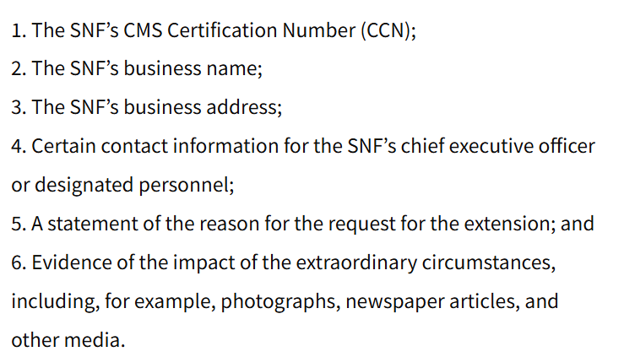
Request for QRP Reconsideration must include:
Therapy services and intellectual property provided by Functional Pathways. ©2025 All rights reserved. This information and materials were created by and is proprietary to Functional Pathways of Tennessee, LLC. Any unauthorized use, dissemination, distribution, or copying of this information and material, in whole or in part, is strictly prohibited.
Notes:
Now you might ask “What information do I need to provide?” well you must include

Slide 23

SNF VBP – Health Equity Adjustment
CMS plans to remove the health equity adjustment so that SNFs can have a clear understanding of the VBP programs incentives
CMS plans to maintain the 60% payback percentage- Yes Medicare keeps 40%!
Approximately $312.53 million to re-distribute
Therapy services and intellectual property provided by Functional Pathways. ©2025 All rights reserved. This information and materials were created by and is proprietary to Functional Pathways of Tennessee, LLC. Any unauthorized use, dissemination, distribution, or copying of this information and material, in whole or in part, is strictly prohibited.
Notes:
VBP: CMS withholds 2% of SNF’s Medicare fee for service Part A payments to fund the program. CMS redistributes 60% as an incentive payment and the remaining 40% of the withheld amount is retained in the Medicare Trust Fund.
Health Equity adjustment will be removed, but what is it actually? The heath equity adjustment rewards healthcare providers, particularly hospitals, for serving patients with social risk factors, such as dual-eligibility for Medicare and Medicaid. It gives bonus points for high-quality care delivered to a greater proportion of vulnerable populations, aiming to promote equity and reduce disparities by reclassifying performance and redistributing payments. CMS has decided to remove this for SNF’s so we can try to better understand VBP programs. Removal of health equity adjustment beginning FY 2027
CMS continues to focus on advancing health equity as a strategic goal so we may see more changes in the future.
So what does Medicare keep?
FY 2026 VBP reduction in payments is estimated to total $208 million
FY 2027 VBP reduction in payments is estimated to total $297 million.
Just something to think about . . . .

Slide 24
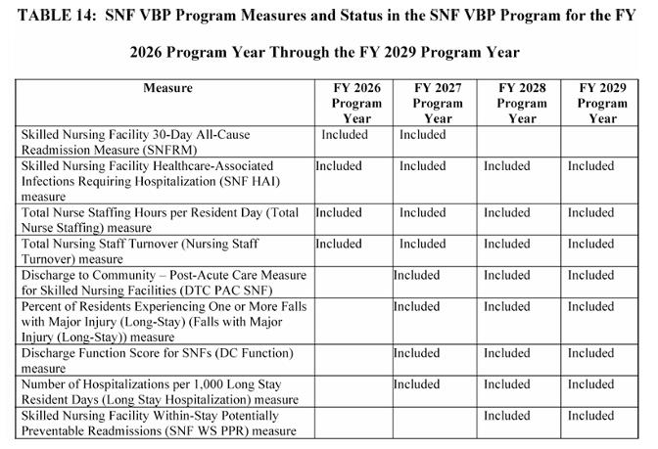
Therapy services and intellectual property provided by Functional Pathways. ©2025 All rights reserved. This information and materials were created by and is proprietary to Functional Pathways of Tennessee, LLC. Any unauthorized use, dissemination, distribution, or copying of this information and material, in whole or in part, is strictly prohibited.
Notes:
FY 2026 VBP program uses data from FY 2022 and the performance period FY 2024 for the four quality measures described above. The three starred items are new this year they join the SNF 30 Day All Cause Readmission Measure- the data comes from Medicare FFS Part A claims, FY 2026 also includes:
Skilled Nursing Facility Healthcare-Associated Infections Requiring Hospitalization-data comes from Medicare FFS Part A claims
Total Nurse Staffing Hours per Resident-data comes from CMS’ Payroll Based Journal (PBJ)
Total Nursing Staff Turnover- data comes from CMS’ PBJ system

Slide 25
SNF Value-Based Purchasing Program
New Reconsideration process to ensure accurate performance scores
Opportunity for a review and correction request if you are not satisfied with CMS decision prior to publication
15 calendar days to submit reconsideration request-starting the day after the date CMS issues a decision via e-mail
Response is via e-mail to SNFVBPquestions@cms.hhs.gov
Therapy services and intellectual property provided by Functional Pathways. ©2025 All rights reserved. This information and materials were created by and is proprietary to Functional Pathways of Tennessee, LLC. Any unauthorized use, dissemination, distribution, or copying of this information and material, in whole or in part, is strictly prohibited.
Notes:
There is also the opportunity for a reconsideration with Value Based purchasing and
A valid request means that “an error in the calculations of the measure results, performance scores or rankings is correctly identified and should be corrected before any affected data becomes publicly available. As you can see on this screen you have 15 days starting after the date CMS issues a decision via e-mail to respond to them. . . with the information we are going to provide on the next slide. The email for CMS is listed here and you can use this for communication with them regarding inaccuracies.

Slide 26
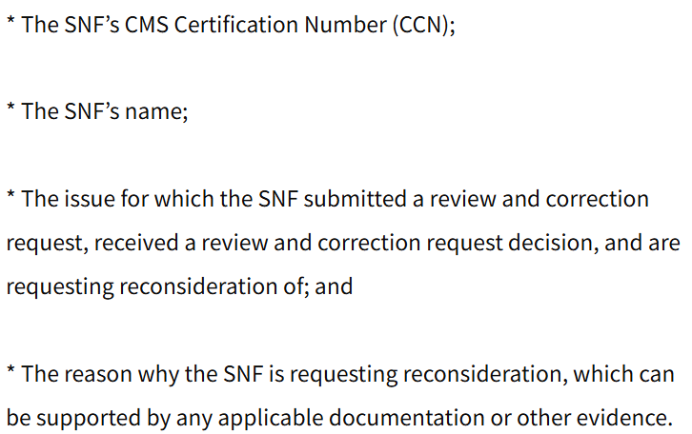
Request for VBP Reconsideration must include:
Therapy services and intellectual property provided by Functional Pathways. ©2025 All rights reserved. This information and materials were created by and is proprietary to Functional Pathways of Tennessee, LLC. Any unauthorized use, dissemination, distribution, or copying of this information and material, in whole or in part, is strictly prohibited.
Notes:
Here is what you should include in the VBP reconsideration
Supporting documentation is the key so provide them with all the evidence and documentation you can find to substantiate your correction request.

Slide 27

Therapy services and intellectual property provided by Functional Pathways. ©2025 All rights reserved. This information and materials were created by and is proprietary to Functional Pathways of Tennessee, LLC. Any unauthorized use, dissemination, distribution, or copying of this information and material, in whole or in part, is strictly prohibited.
Notes:
Alright Michael “Open up that beautiful poll and lets see what they have to say , , ,”

Slide 28
SNF Data Validation Process
Validate the MDS responses with the medical record - Accuracy of MDS based Quality Measure questions
Can lose 2% from Part A Annual Payment Update
Selection Process
Only via iQIES MDS 3.0 Provider Preview Reports Folder
“SNF Data Validation Process-Initial Selection Notification”
*Ensure someone is assigned to check this folder daily
10 random records with required data submission response within 45 days of notice . . . Or lose 2%
Skilled Nursing Facility Validation Program: Frequently Asked Questions
Data Validation Process | CMS
Therapy services and intellectual property provided by Functional Pathways. ©2025 All rights reserved. This information and materials were created by and is proprietary to Functional Pathways of Tennessee, LLC. Any unauthorized use, dissemination, distribution, or copying of this information and material, in whole or in part, is strictly prohibited.
Notes:
This was outlined in the 2024-2025 rules and now it is here. CMS is looking at accuracy of MDS QM information and this can cost you 2% of your Part A Annual Payment Update. Who has access to your IQIES reports both the facility and resident? They will request the information in the Provider Preview Reports Folder and it will be titled “ SNF Data Validation Process-Initial Selection Notification” so who is looking for this in your community, you need to be checking this folder daily and who will respond with the information within 45 days? They will request 10 records at random.
Auditing is already in process as of Oct 1, 2025
There are links on this slide that will help you with understanding the process and FAQ’s.

Slide 29

FALLS
New definition for a fall:
Unintentional change in position coming to rest on the ground, floor or onto the next lower surface (e.g., onto a bed, chair or bedside, mat) or the result of an overwhelming external force (e.g., a resident pushes another resident)
Intercepted fall occurs when the resident would have fallen if they had not caught themselves or had not been intercepted by another person – this is still considered a fall.
Therapy services and intellectual property provided by Functional Pathways. ©2025 All rights reserved. This information and materials were created by and is proprietary to Functional Pathways of Tennessee, LLC. Any unauthorized use, dissemination, distribution, or copying of this information and material, in whole or in part, is strictly prohibited.
Notes:
So my college Dani Beveridge felt would be doing you all a dis-service if we didn’t mention falls during this presentation. So there is a new definition as you see above . . . . Coding tips also are present that clarifies intentional therapeutic interventions that challenge balance during supervised therapy sessions.
The Department of Health and Human Services Office of Inspector General released a report examining the accuracy of nursing home reporting of major falls with injury. They compared hospital claims to Nursing Home MDS’ and found that nursing homes failed to report 43% of falls with major injury that led to hospitalizations among Medicare-enrolled residents. The OIG believes that these findings undermine the transparency for families making care decisions and CMS’s oversight efforts.
They also found that for-profit, chain affiliated, and larger nursing homes were the most likely to under-report falls.
If you need help with your falls reach out to your Director of Rehab, Area Director of Operations or your FP clinical partners so we can discuss options to assist with keeping our residents off the ground, aging in place and living their best lives. We have a Core4+ program called Be Steady that looks at fall prevention and gives the IDT tools to combat falls in our communities. Let us know if we can partner with you on this adventure . . .
Theyn also changed the language to say the factors related to major injury are the four initial items:
Joint dislocation Closed Head Injury with altered consciousness and Subdural Hematoma
Now the langage is “but not limited to”
Traumatic bone fracutres, joint dislocations, subluxations, internal organ injuries, amputations spinal cord injuries, head injuries and crush injuries.

Slide 30

LS Antipsychotic QM:
Where do they get the data–
Medicare and Medicaid-claims data
Medicare Advantage-encounter data
Capture antipsychotics prescribed during the nursing home stay not just the 7 day look back period
January 28, 2026 – incorporated into Care Compare
Therapy services and intellectual property provided by Functional Pathways. ©2024 All rights reserved. This information and materials were created by and is proprietary to Functional Pathways of Tennessee, LLC. Any unauthorized use, dissemination, distribution, or copying of this information and material, in whole or in part, is strictly prohibited.
Notes:
CMS feels that the history with schizophrenia diagnosis as well as the use of antipsychotic medications is under reported by SNF’s. Because this is part of the Care Compare 5-star rating, they want to make sure that the SNF’s are representing their true use of this medication. Not only those that are prescribed antipsychotic medications but also those that receive it. The national percentage of residents receiving antipsychotics is 14.64% under the current method of data collection. Under the new data collection process, this will increase to 16.98% because of the additional data they are pulling.

Slide 31
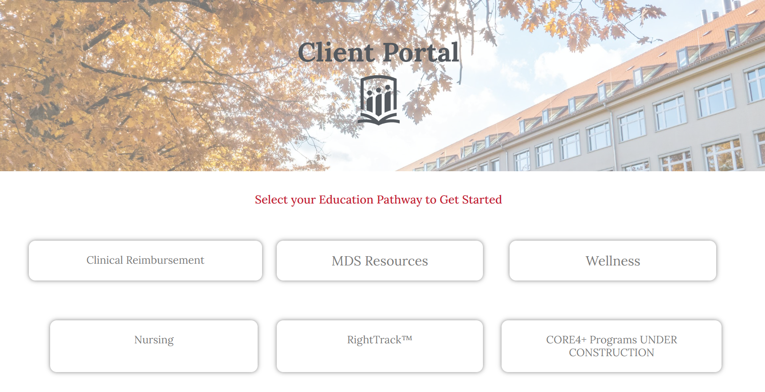
FP Client Portal
https://portal.fprehab.com
Password: academypath
Therapy services and intellectual property provided by Functional Pathways. ©2025 All rights reserved. This information and materials were created by and is proprietary to Functional Pathways of Tennessee, LLC. Any unauthorized use, dissemination, distribution, or copying of this information and material, in whole or in part, is strictly prohibited.
Notes:
We wanted to direct you all to our partners to the client portal where you can find this presentation as well as other resources like past CRS presentations, Wellness information and resources, MDS bootcamp and resources, nursing tools and information on our RightTrack software. There is More to come like Core4 resources that are on the way to our client portal. If you need additional help with this you can reach out to your DOR, ADO or FP clinical partners to support you.

Slide 32

Clinical@fprehab.com
Jennifer Callahan – Director of Clinical and Reimbursement Services – jcallahan@fprehab.com
​Michael Wayman – Clinical Outcomes and Reimbursement Specialist – mwayman@fprehab.com
Melissa Brandt – Clinical Outcomes and Reimbursement Specialist – mbrandt@fprehab.com​​
​
Brittany Austin – National Director of Health and Wellness – baustin@fprehab.com ​
​
Dani Beveridge – Clinical Program Specialist – dbeveridge@fprehab.com ​
​
Therapy services and intellectual property provided by Functional Pathways. ©2025 All rights reserved. This information and materials were created by and is proprietary to Functional Pathways of Tennessee, LLC. Any unauthorized use, dissemination, distribution, or copying of this information and material, in whole or in part, is strictly prohibited.
Notes:
Michael and I want to Thank you all for joining us and we look forward to you attending our CRS next week where Dani and Brittany will present: Thriving in Place: ​A Chronic Disease Management Guide for AL and IL
Have a great rest of your day!

Slide 33
References:
Federal Register :: Medicare Program; Prospective Payment System and Consolidated Billing for Skilled Nursing Facilities; Updates to the Quality Reporting Program for Federal Fiscal Year 2026
SNF Medicare Part A Proposed Rule Changes for October 1st 2025: What Therapy & MDS Professionals Need to Know - Montero Therapy and MDS Services
Polaris Group | Key Updates for SNFs in FY 2026 and MDS 1.20.1
https://www.monterotherapyservices.com/info-blast/snf-pdpm-mds-part-a-changes-for-october-1st-2025-what-therapy-mds-professionals-need-to-know/
https://www.cms.gov/files/document/final-mds-3-0-rai-manual-v1-20-1-october-2025.pdf
https://www.aapacn.org/article/fy-2026-snf-pps-final-rule-section-r-removal-tops-the-list-of-changes/
Therapy services and intellectual property provided by Functional Pathways. ©2025 All rights reserved. This information and materials were created by and is proprietary to Functional Pathways of Tennessee, LLC. Any unauthorized use, dissemination, distribution, or copying of this information and material, in whole or in part, is strictly prohibited.

